Slide 1
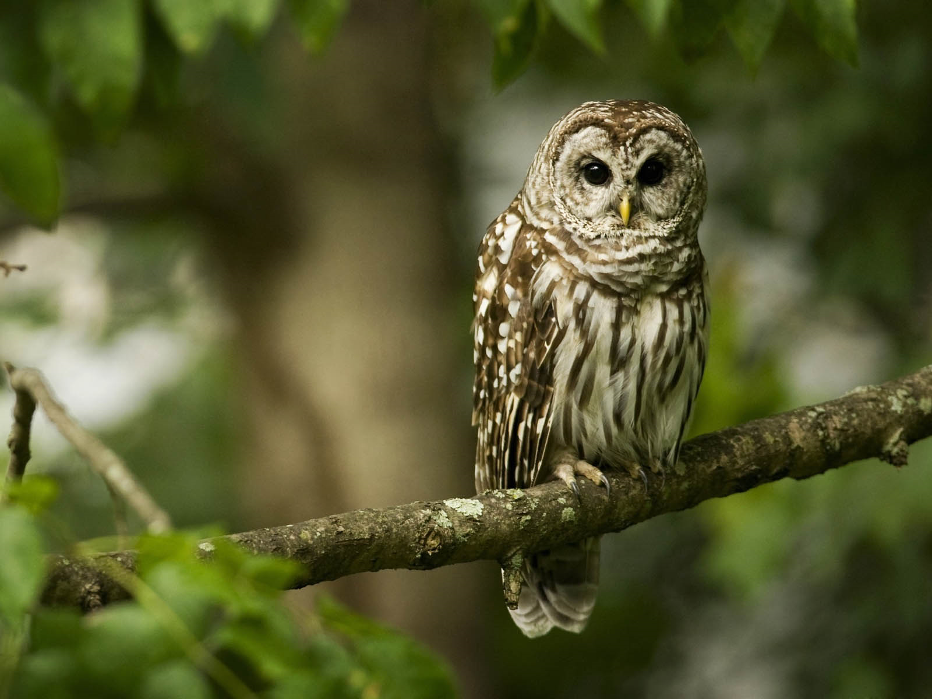
Welcome to Owls Class
2025-26

Slide 2
Children to be dropped off at the school gates and will be greeted by Mrs Cowling between 8.45 and 8.55am. The children will then come straight to their classroom.
If you’re late please come to the school office to sign in.
If you need to speak to a member of staff please either email or phone the school office.
admin@bishopmonkton.n-yorks.sch.uk
01765 677583

Slide 3
End of day…
At the end of the day the children are to be collected from the Owls classroom door. They will handed over by a member of staff.
If your child is going home with a different adult please inform the school office. This is to ensure your child's safety.

Slide 4
Water bottles need to be in school every day and labelled.
Children will need a labelled PE kit in school. These will be sent home each Thursday and will need to be returned Monday mornings. Our PE days are Tuesday and Thursday.
Your child will need a swimming kit every Wednesday.
Your child will need a school bag.

Slide 5
Homework
Children have access to Spelling Shed, TT Rockstars and DuoLingo.
We are planning on doing more project style homework this year – more information to follow.
Spellings will be stuck in their red spelling books every Friday, with a spelling check the following Friday.
Please can the red spelling books be brought to school daily so the children have access to them in order to practise.

Slide 6
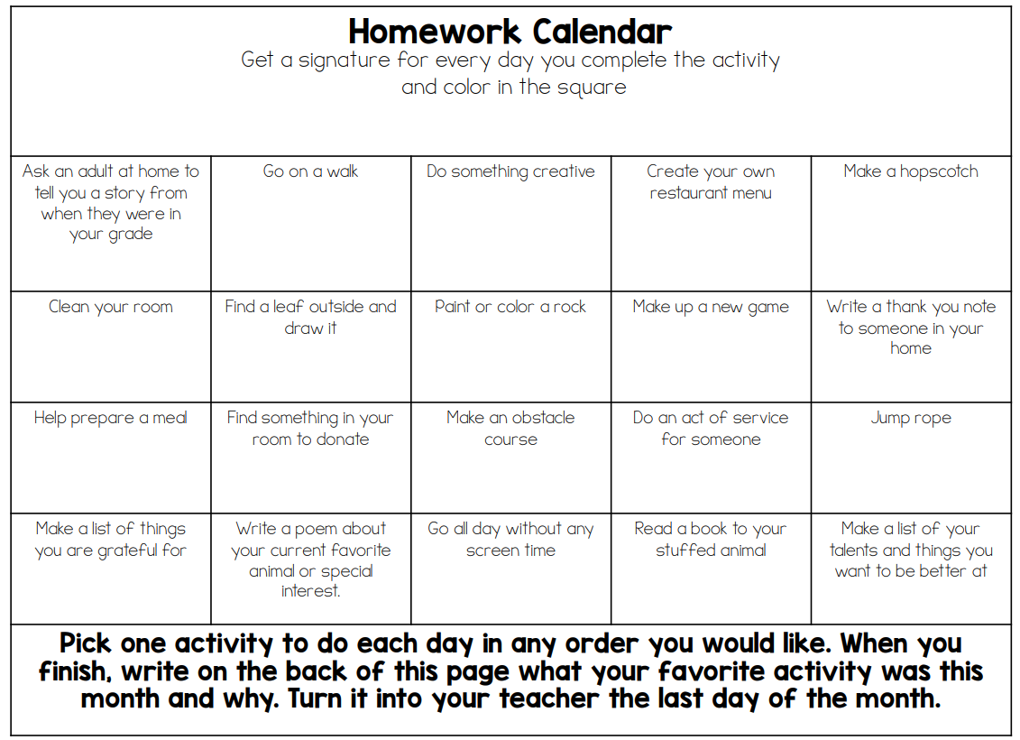

Slide 7
Reading
Please try and share a book with your child everyday at this age. Please record any reading at home in your child’s reading record.
We hear the Y3 children during whole class reading practice and the Y2’s are listened to within their Little Wandle phonics.
Owls has a mix of children on Little Wandle and Book Life.
Little Wandle books come home weekly and Book Life books will be changed when the children have completed their book.
The aim is not to rush through the scheme but to develop a deeper understanding.

Slide 8
Y3 Robin Wood
In June we will be visiting Robin Wood (Alston, Cumbria) for outdoor adventures.
There will be more information to follow.
Please have a look at their website to see some of the activities we will be doing. How exciting!
https://www.robinwood.co.uk/

