Slide 1

Welcome to our phonics and reading information sharing session.

Slide 2
Phonics and Early Reading
Part 1 – information about how we teach phonics
Part 2 – information about how we teach reading
Part 3 – supporting at home

Slide 3

What is Phonics?
Phonics is a way of teaching children how to read and write.
It helps children hear, identify and use different sounds that distinguish one word from another in the English language

Slide 4
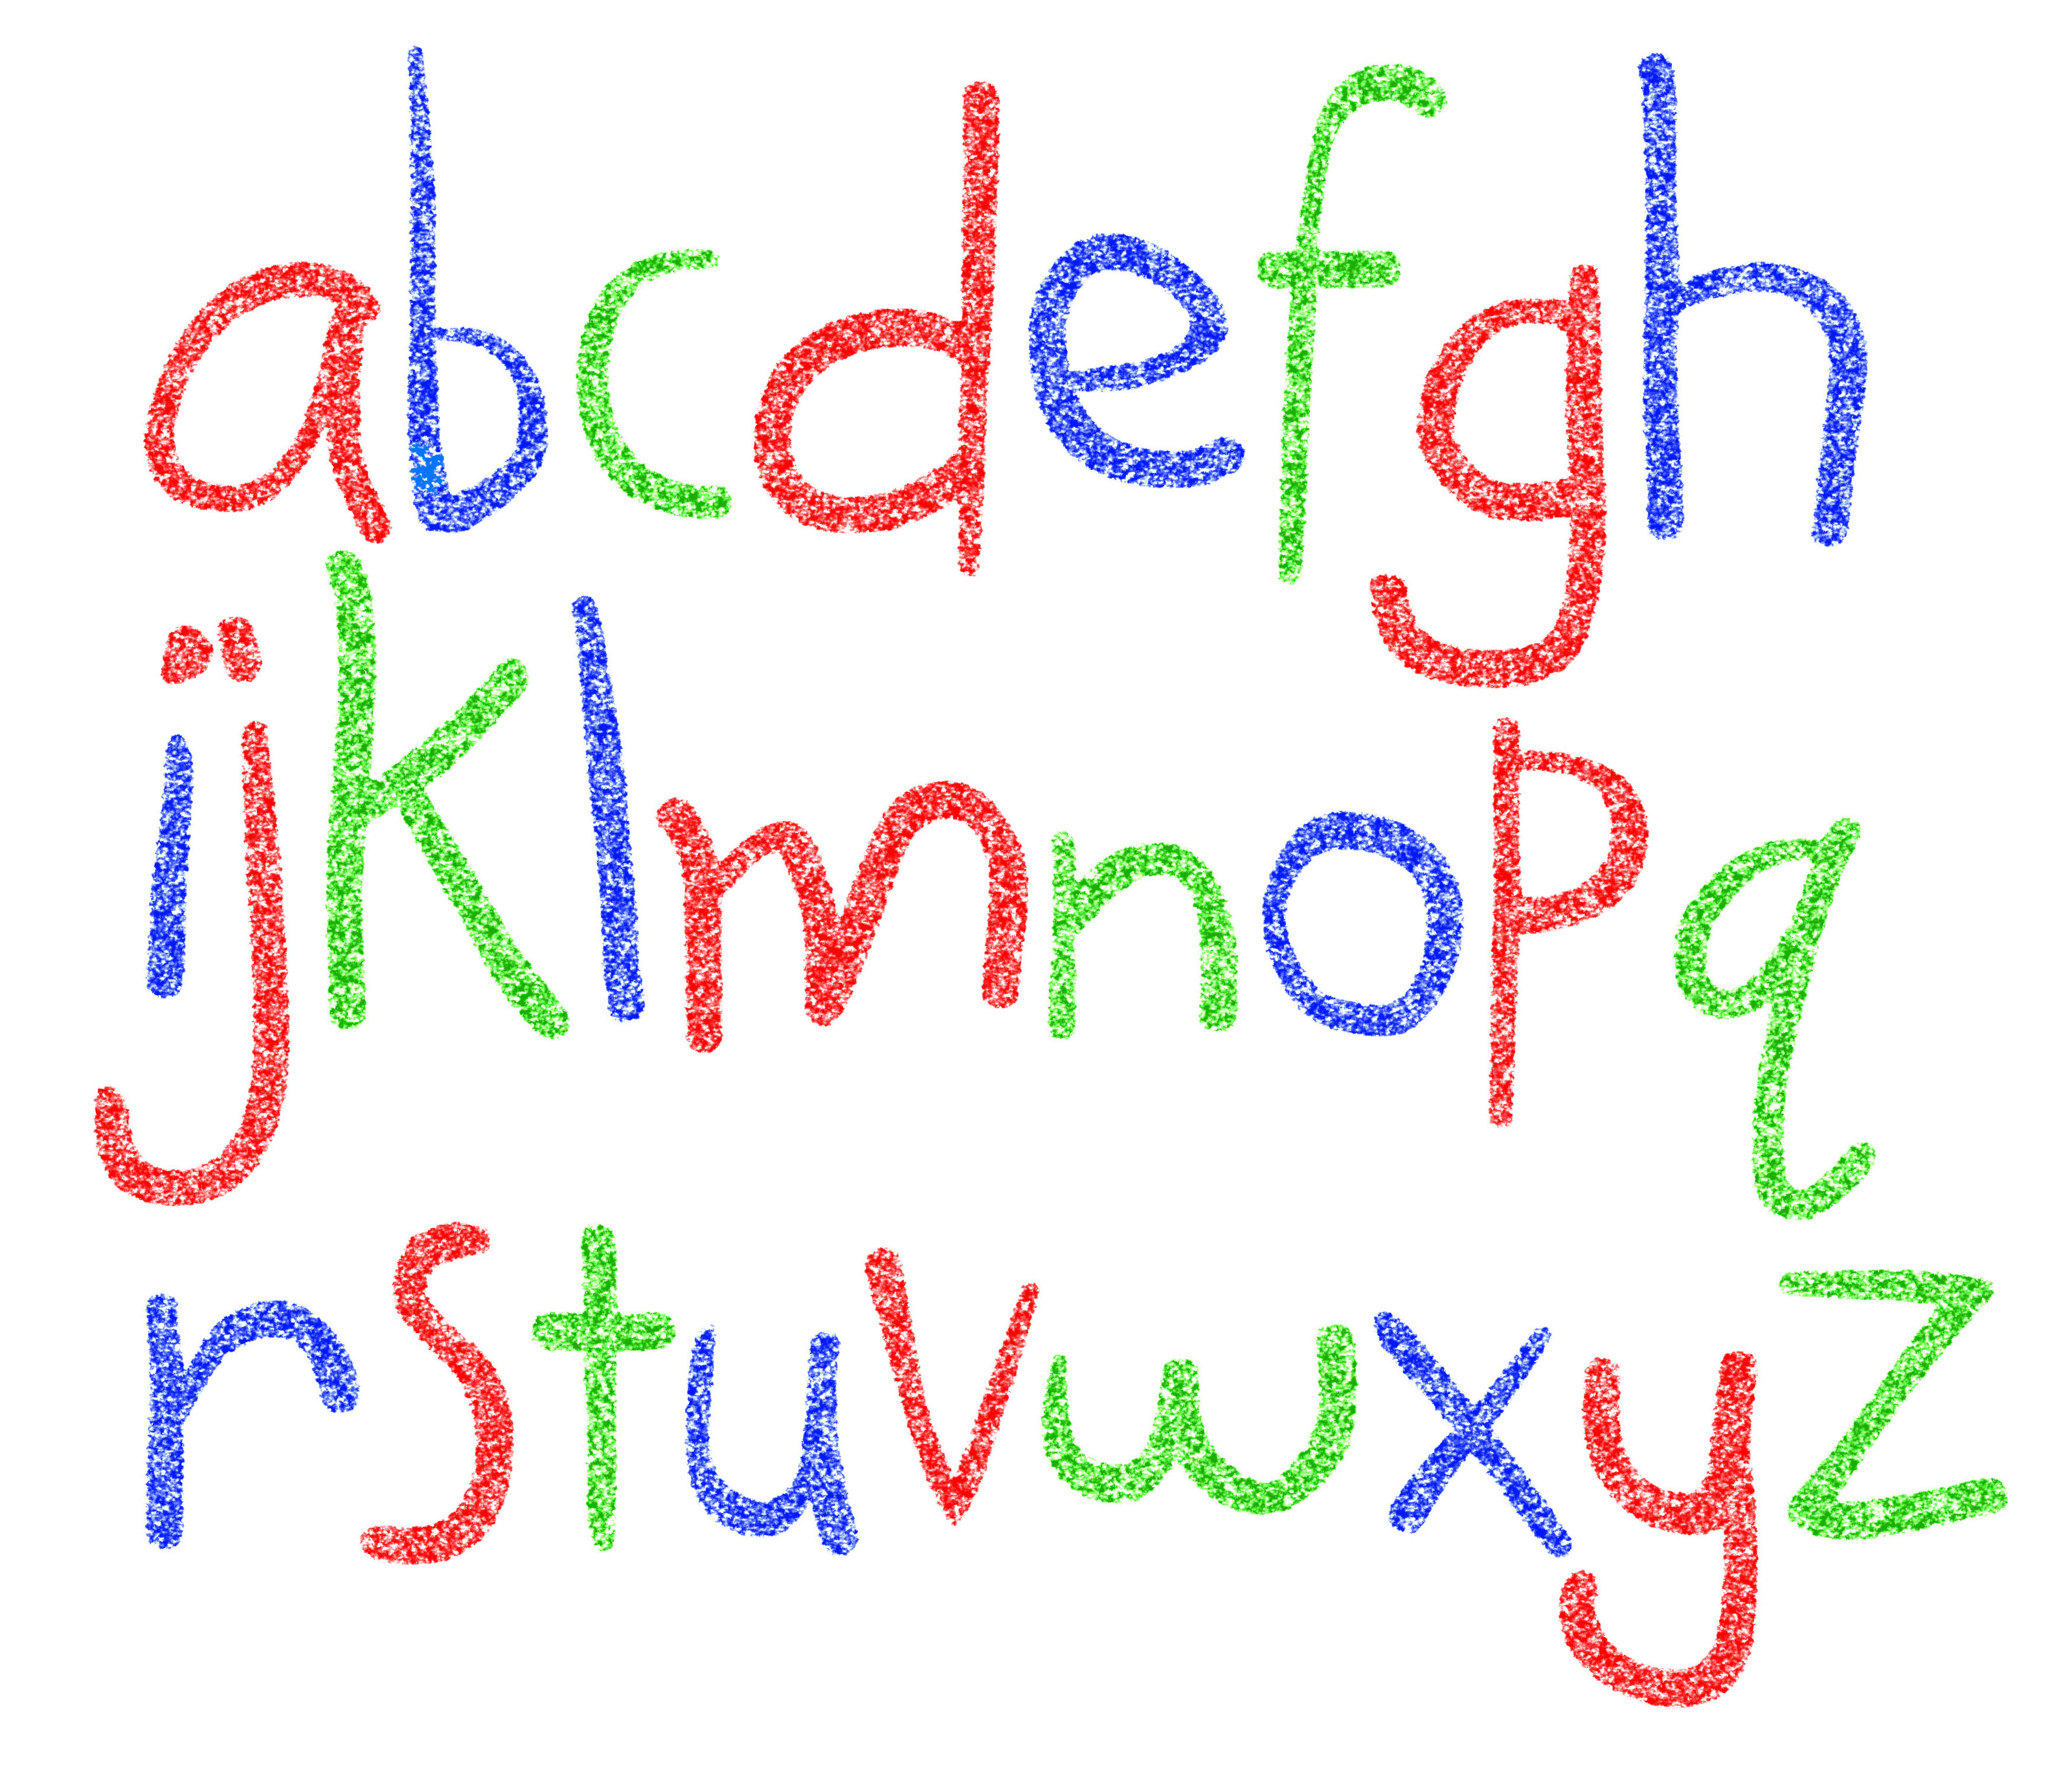

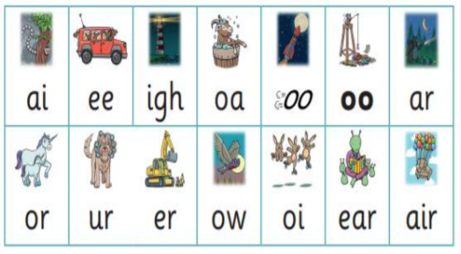
Did you know?
The English language has:-
26 letters
44 sounds
Over 100 different ways to spell
those sounds

Slide 5

New DFE Guidance for Early Reading and Phonics
The journey to independent reading and writing begins with Phonics
littlewandlelettersandsounds.org.uk
Why Little Wandle?
Excellent training for all staff to ensure consistency.
Every aspect of phonics and reading included in a detailed, thorough and systematic approach.
Engaging resources without distracting from the learning.
Comprehensive system for identifying and supporting children requiring extra help
Useful support for parents.
Notes:
Government changes mean a change (for the better) in how we teach phonics and reading at school - make sure there is consistency throughout
Early reading is the stage where children are learning to become fluent readers through the use of phonics

Slide 6
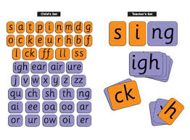
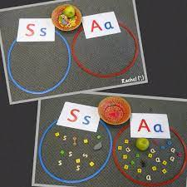
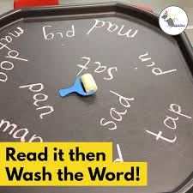
How we teach phonics
Daily short sessions
Specific order of teaching
m-u-s-t
Synthetic phonics
Correct pronunciation is vital – No schwarring!
https://youtu.be/IL5YUCPyC5I
Repeated practice
Revisit previously
taught sounds at
start of each lesson
Practice makes
permanent

Slide 7
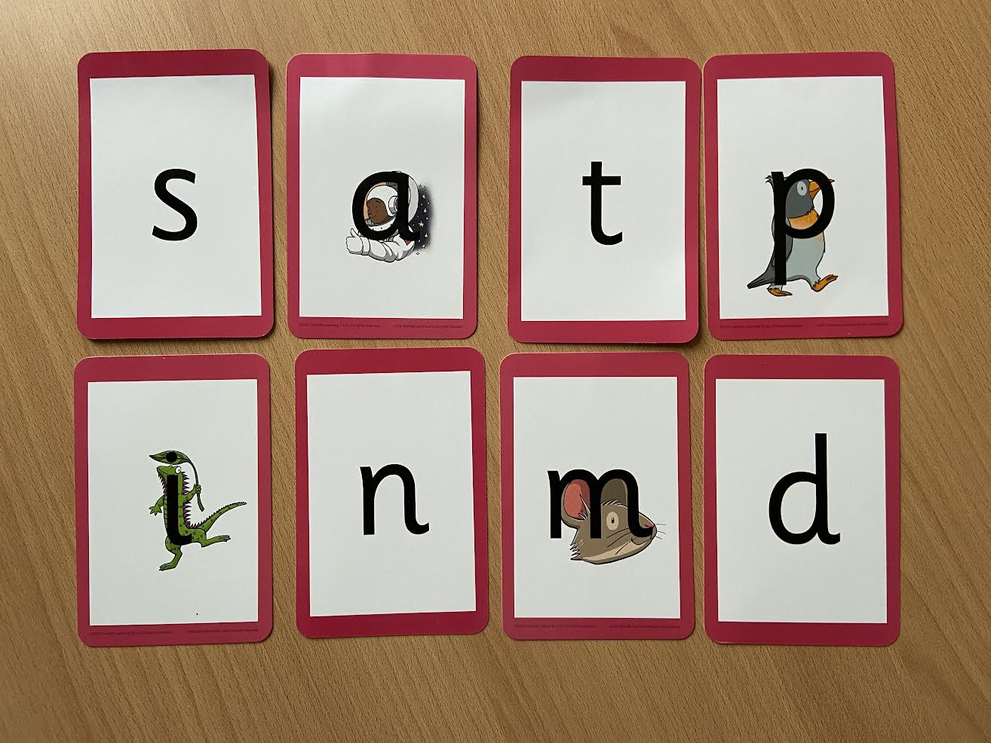
Notes:
Phonemes taught in order start to read words asap
LW has a picture pneumonic to help children remember the phoneme/grapheme

Slide 8
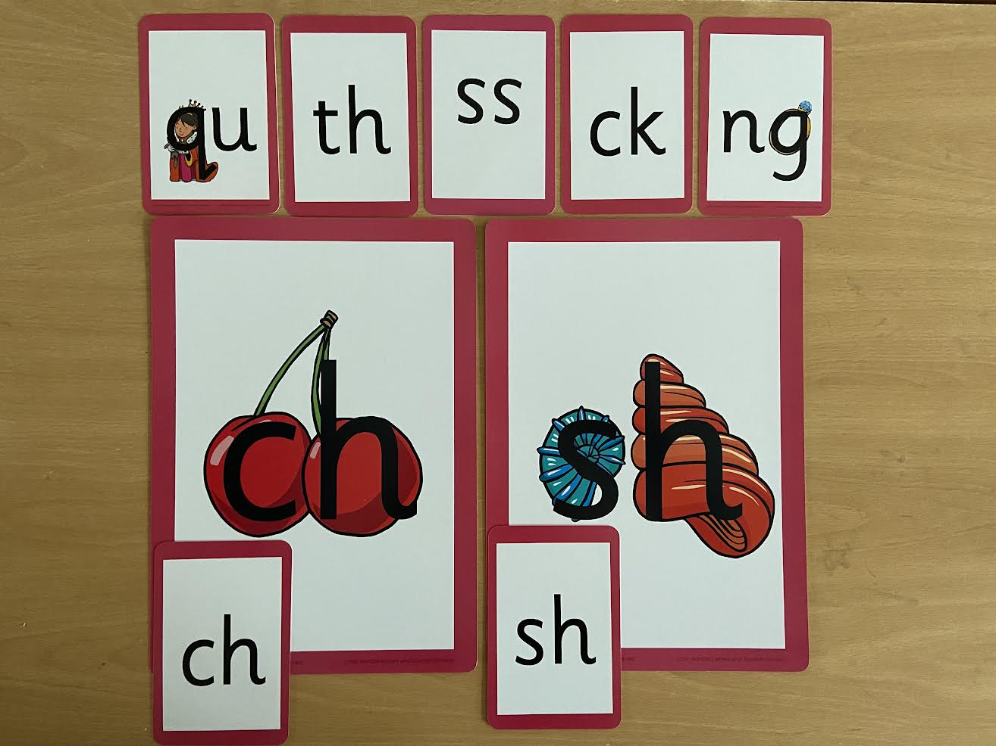
Notes:
Early digraphs mostly consonant digraphs – 2 letters 1 sound

Slide 9
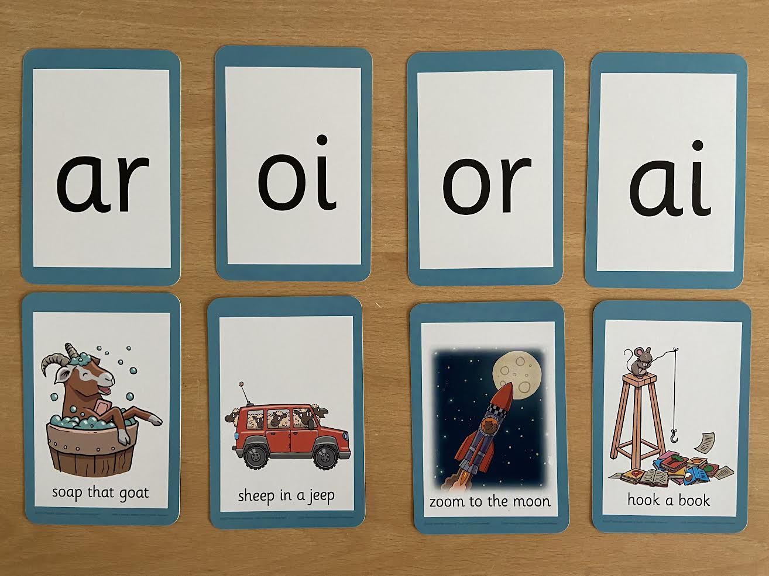
Notes:
Vowel digraphs taught with a short caption to help children remember
Also trigraphs igh, air

Slide 10
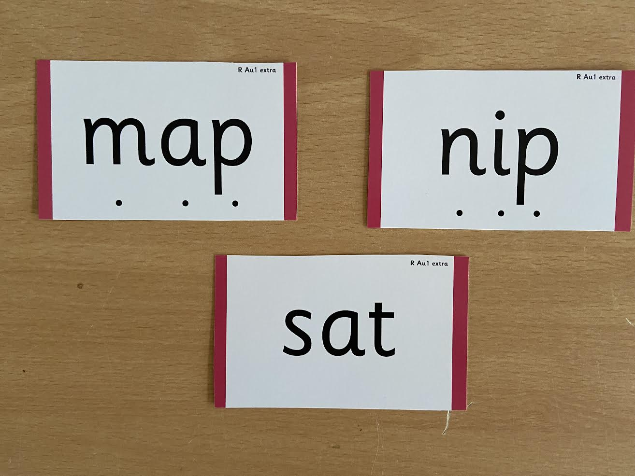
Notes:
During phonics lessons we use Sound buttons so we can sound talk and blend to read

Slide 11
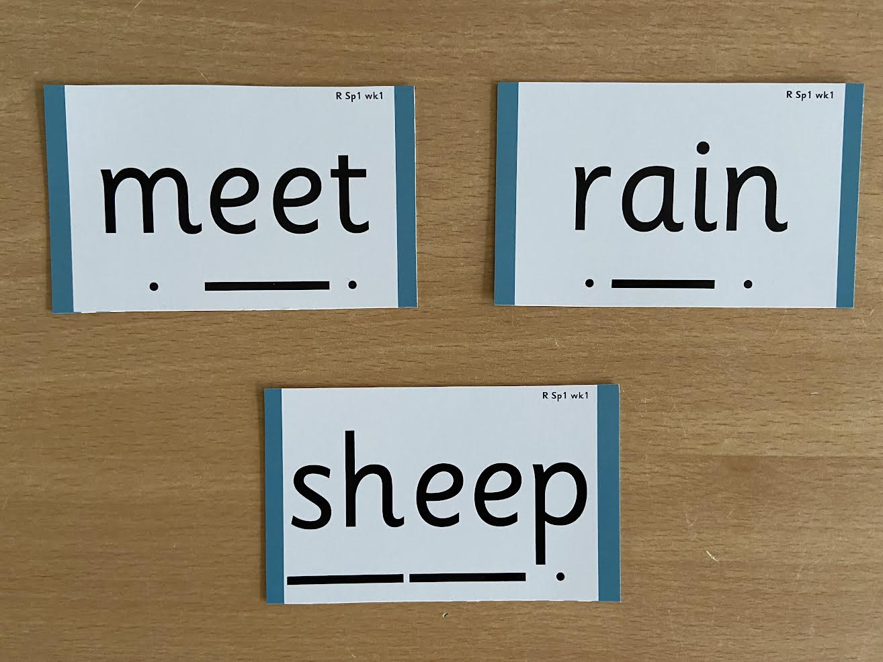
Notes:
Digraphs have a zip to sound talk and blend

Slide 12

Notes:
Words that do not follow the rules and cannot be decoded – tricky words/ exception words
Chn are taught what part of the word is tricky

Slide 13

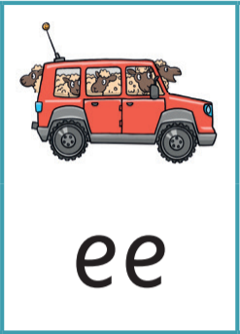

Jargon
You may hear your children say….
-phonics (also known as ‘synthetic phonics’) – The teaching of reading by developing awareness of the sounds in words and the corresponding letters used to represent those sounds.
-phoneme - Any one of the 44 sounds which make up words in the English language.
-grapheme – How a phoneme is written down. There can be more than one way to spell a phoneme. E.g-the phoneme ‘ay’ is spelt differently in each of the words ‘way’, ‘make’, ‘fail’, ‘great’, ‘sleigh’ and ‘lady’.
-blending – Putting together the sounds in a word in order to read it, e.g.
‘f – r – o – g, frog’
-segmenting – Breaking a word into sounds in order to spell
them, e.g. ‘frog, f – r – o – g’’
-Digraph- 2 letters making one sound
-Trigraph- 3 letters making one sound

Slide 14

Reading
We want children to
love reading
Learning to read should be
a positive experience
Reading should be
enjoyable
We want children to read
for pleasure and be life
long readers
Reading underpins children’s access to the curriculum
and clearly impacts on their achievement
Notes:
We all know how important learning to read is and the impact it has on a childs success - it has to be a positive experience
Whats the reality? Reluctant to read because they find it hard
Frustration stress tears – that’s just the parents
Important to look at the big long term picture

Slide 15

How we teach reading
Reading practice sessions are :
Timetabled 3 times a week
Taught in small groups
Taught by trained teacher or
teaching assistant
Books are :
matched to children’s
secure phonic knowledge
and word reading
read three times before sent home
Notes:
Quite a big difference to how reading was previously taught

Slide 16
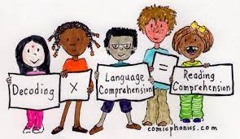
Reading Practice Books carefully matched so children can read
fluently and independently
3 Reads – each one begins with some quick sounds and words practice
Decoding
Prosody
(intonation, expression)
3. Comprehension
When children take their book home to read they should be 95% fluent.
Please do not worry that a book is too easy – your child needs to develop
fluency and confidence in reading. Re-reading a book they have had before
helps develop fluency – this is the goal.
Celebrate their success!!! Be positive.

Slide 17
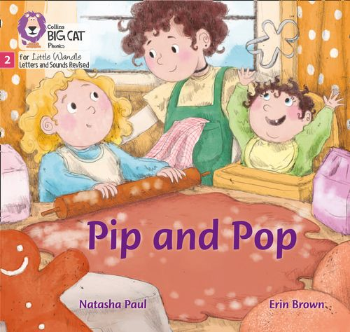

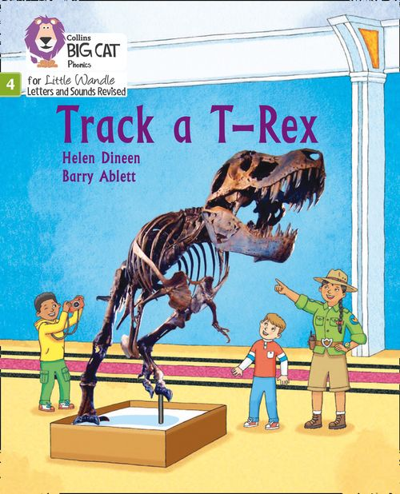
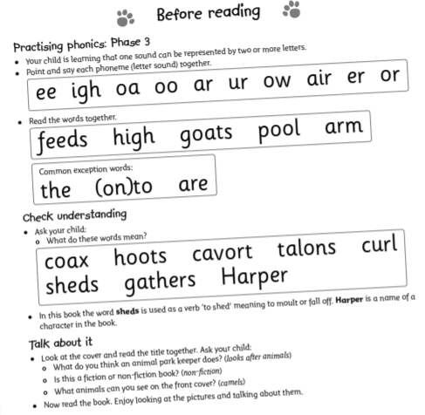
How do we decide which books children read?
Children are assessed, then LW matches which books
Should be allocated for their secure phonic knowledge.
Children will take their Reading Practice Book home
(after reading it 3 times in school)
.
Share the front cover page before reading – this
cover sounds and words contained in the book.
Celebrate, praise, talk about the book with you child.
Please make sure books are in book bags and
returned on Monday as they may be
needed for other groups.
Please look after our books.
Notes:
Children will not be changing book multiple times a week as previously
Reading groups will be set up so you will be notified of when your book will be sent home/ need to be back in school
Groups will change!

Slide 18





Supporting at home.
Reading for pleasure books
Children will also bring home a ‘reading for pleasure book’ from our class library each week.
To become lifelong readers, it is essential that they read for pleasure
Children may not be able to read this book independently but these books offer a wealth of opportunities for talking about the pictures and enjoying the story or information text.
Enjoy the book together and
foster a love of reading

Slide 19
What else can parents do?
Please look at the Little Wandle videos and guidance for parents
Support children in learning the alphabetic code
Let your child “show off” their reading to you and celebrate and praise all the way!
Share books with your children for pleasure
Check on your class page for documents to support reading and phonics

Slide 20
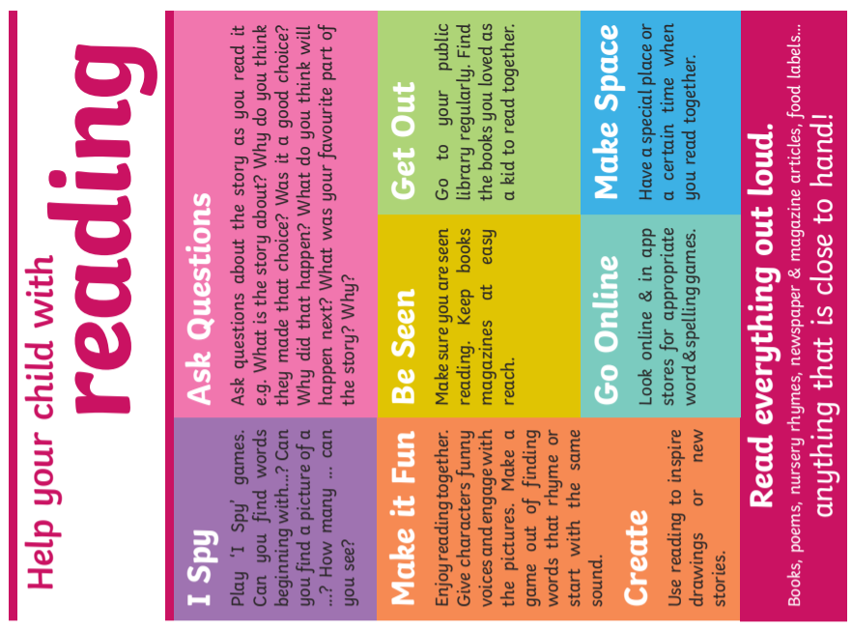


Slide 21
Websites for Phonics games:
Phonics Play - https://www.phonicsplay.co.uk/
Phonic Bloom - https://www.phonicsbloom.com/
Topmarks - https://www.topmarks.co.uk/english-games/5-7-years/letters-and-sounds

Slide 22
Thank you for joining us
Questions ???

