Slide 1

Year 6 trip to East Barnby
2nd June – 6th June 2025

Slide 2
The East Barnby Centre
The Centre is a secure environment. At night, the dormitory buildings are alarmed and secured.
A member of East Barnby staff is on duty throughout the night, in addition to Bishop Monkton School staff.
Each dormitory has shower and toilet facilities.
The boys will be in a room together and the girls will be in a room together.

Slide 3
Health and Safety
East Barnby Outdoor Education Centre is owned and run by North Yorkshire County Council. The East Barnby liability insurances certificate can be found at: www.outdoored.co.uk/resources/section/legaldocuments
These documents are annually renewed and updated on the website at the end of September. East Barnby is licensed and inspected annually by the Adventurous Activities Licencing Authority (AALS) to ensure the standard and quality of the East Barnby health and safety procedures.

Slide 4
Staff
Bishop Monkton School staff attending East Barnby:
Mrs McMahon
Miss Riddler
Mrs Burnett (1:1)
Mrs Cowling (Visiting Wednesday and Thursday)
Each activity group is led by a member of the East Barnby Teaching Staff accompanied by one member of Bishop Monkton School staff.

Slide 5
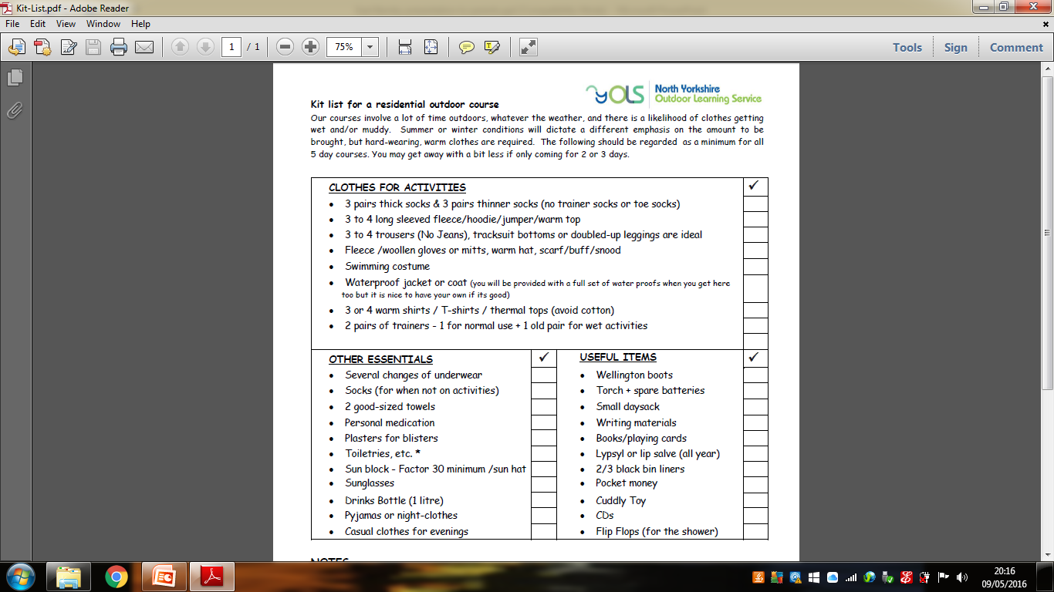
Kit List
The centre will provide full waterproofs and wellington boots for fieldwork.

Slide 6
OTHER USEFUL ITEMS
Writing materials (pencil/pen)
Book to read / a small quiet game
A small back pack to hold your lunch
Small unbreakable flask (named on the side or lid)
2/3 empty plastic bags/ black bin liners (named) – for wet clothing/dirty washing
WHAT NOT TO BRING
We recommend that the following items are not appropriate at East Barnby: Radios, Mobile phones, Jewellery, PSP’s, and similar computer games
Extra food or sweets (Meal time food is more than sufficient and there is a tuck shop)
PLEASE LABEL ALL CLOTHES AND EQUIPMENT!!
* Please ensure that your child helps to pack their own case so they can identify their own items. Children should also be able to carry their suitcase once it has been packed.

Slide 7
Timetable- Monday
8:40: Arrive at school. Parents and children come into Kites classroom with baggage. Ensure that medicine forms are completed and medicines are handed in to Mrs McMahon. No medicine is to be carried by the children and all medicine (including hayfever tablets, travel sickness tablets, paracetamol) MUST be handed in. No medicine can be administered without a medical form.
10:30 - 11:30: Arrive at centre, if possible settle into dormitories (make own bed!!) and waterproofs/ wellington boots issue.
12.00: Welcome talk from East Barnby staff
12.30: Lunch *provided by home.
13.00: Divide into groups and get ready for the afternoon's activities – body boarding
16.30: Return from activity
17.30: Evening meal
19:00: Evening activity
21:15: Chn supervised prepare supper and prepare breakfast for following day.
21.30: Supper
22.00: Bed time

Slide 8
Tuesday/ Wednesday/ Thursday
07.30 Wake up
08.30 Breakfast
09.00 Get ready for the day's activities
09.30 Begin activity
16.30 Return from activity
17.30 Evening meal
19:00 Evening activity
21:15 Chn supervised prepare supper and prepare breakfast for following day.
21.30: Supper
22.00: Bed time

Slide 9
Friday
07.30 Wake up
08.30 Breakfast and vacate rooms
09.00 Get ready for the mornings activity
09.30 Begin activity
12.00 Return from activity
12.30 Packed lunch
13.00 Course debrief
13.30 Depart for home
15:00-15:30 Arrive back at school (with lots of dirty washing!!)

Slide 10
Daytime Activities
 | Morning | Afternoon
Monday |  | Body Boarding
Tuesday | Orienteering Mountain Biking | Mountain Biking Orienteering
Wednesday | Canoeing | Canoeing
Thursday | Rock Climbing | Rock Climbing
Friday | Seashore Adventure
All activities are subject to change according to weather conditions and assessments made by East Barnby staff.

Slide 11
Evening Activities (may alter)
Every evening each dormitory has an inspection and children can earn points in the ‘Best Dorm Competition.’ Children will also complete diary entries every evening.
Evening Activities (these may change!):
Monday: Un-pack, Nightline
Tuesday: Games night and Quiz
Wednesday: Talent Show
Thursday: Campfire and games

Slide 12
Meals
Children will be using lots of energy at East Barnby, so will be well fed.
Breakfasts include a full cooked breakfast as well as cereal and toast.
Packed lunch and drinks (a hot or cold is available) are provided daily. There is a cooked meal each evening.
After the evening activities, children will be given a drink and snack before bedtime.
*They can also cater for any dietary requirement from vegetarian to celiac. Any special dietary requirements can always be discussed in advance with their Head Cook (please let me know too!).

Slide 13
Tuck shop
East Barnby is home to a small tuck shop that can be opened after tea at the request of the visiting staff.
The tuck shop sells a range of healthy juice and water drinks as well as numerous souvenirs which are available at very reasonable prices.
The children will be allowed to bring money. The limit is £10. Please bring money in labelled purse/wallet and small change would be better than notes.
On two evenings the Tuck Shop will be open for 15 minutes or so from 6.30pm with Centre staff behind the counter.
The Tuck Shop sells a wide variety of chocolates, drinks and sweets. East Barnby pens, pencils, baseball caps ,T shirt, Barnby Bears

Slide 14
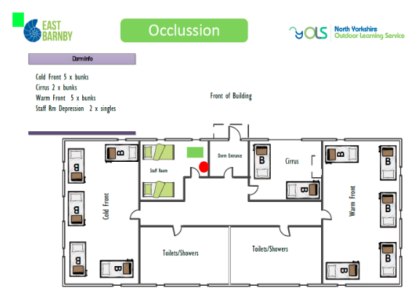
Dormitories

Slide 15

Any questions?
Further information can be found on the East Barnby website: www.outdoored.co.uk/our-centres/east-barnby
We look forward to a very busy week with your children taking part in lots of exciting and enjoyable learning experiences.
We will try our best to add photos to our Kites class page at the end of every day so please do keep checking the page. I will create a folder on the page called ‘East Barnby’.

