Slide 1
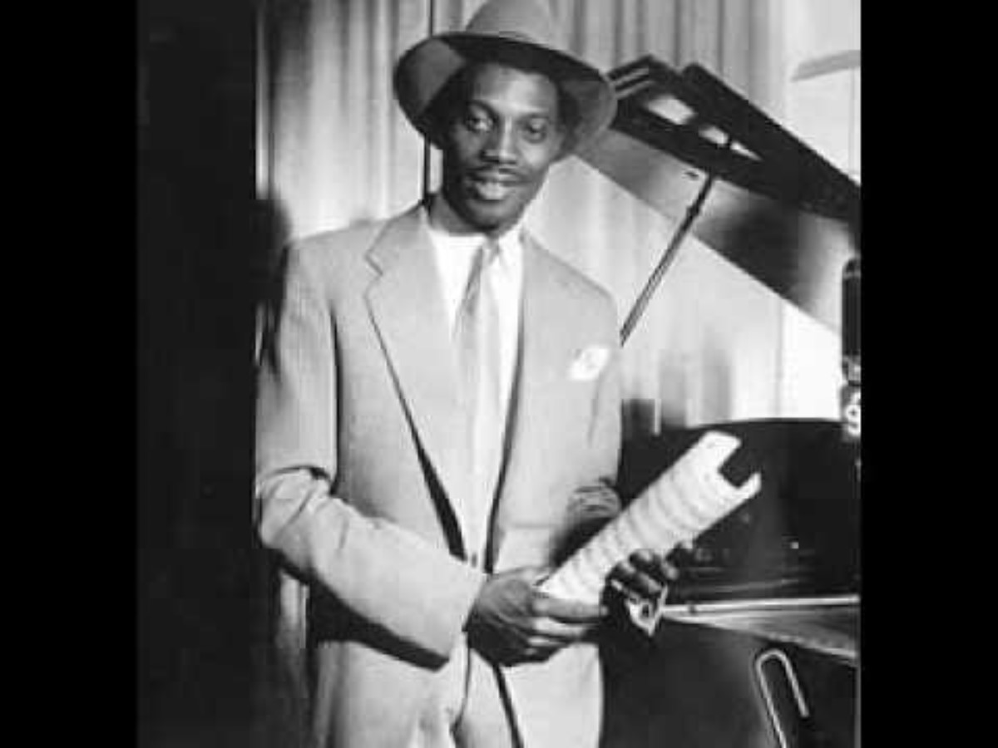
The empire Windrush-a history
By sylvia Stoffel

Slide 2
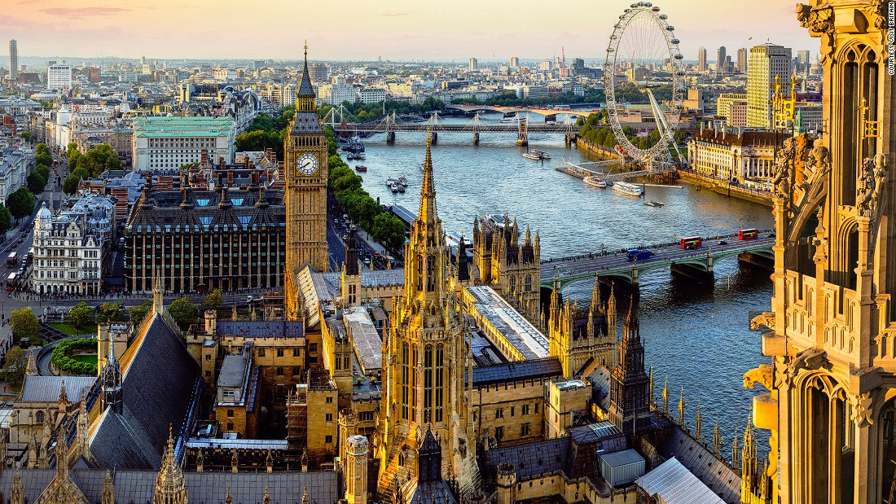
what was the Windrush?
“the streets where almost paved with gold”
the empire Windrush was launched in 1930 and was named the mv monte rose , it originally served as a Nazi cruise ship and later as a troop and prison ship used to deport Jews to Auschwitz.[ a concentration camp .] after the war the British claimed it and renamed it the empire Windrush . The next mission was to convert it , at this time Britain was poor and needed help so they people to come and make some money . They told all the people from the around the world to come to England . They told them the streets where almost paved with Gold, this is what led to the British nationality act 1948.

Slide 3
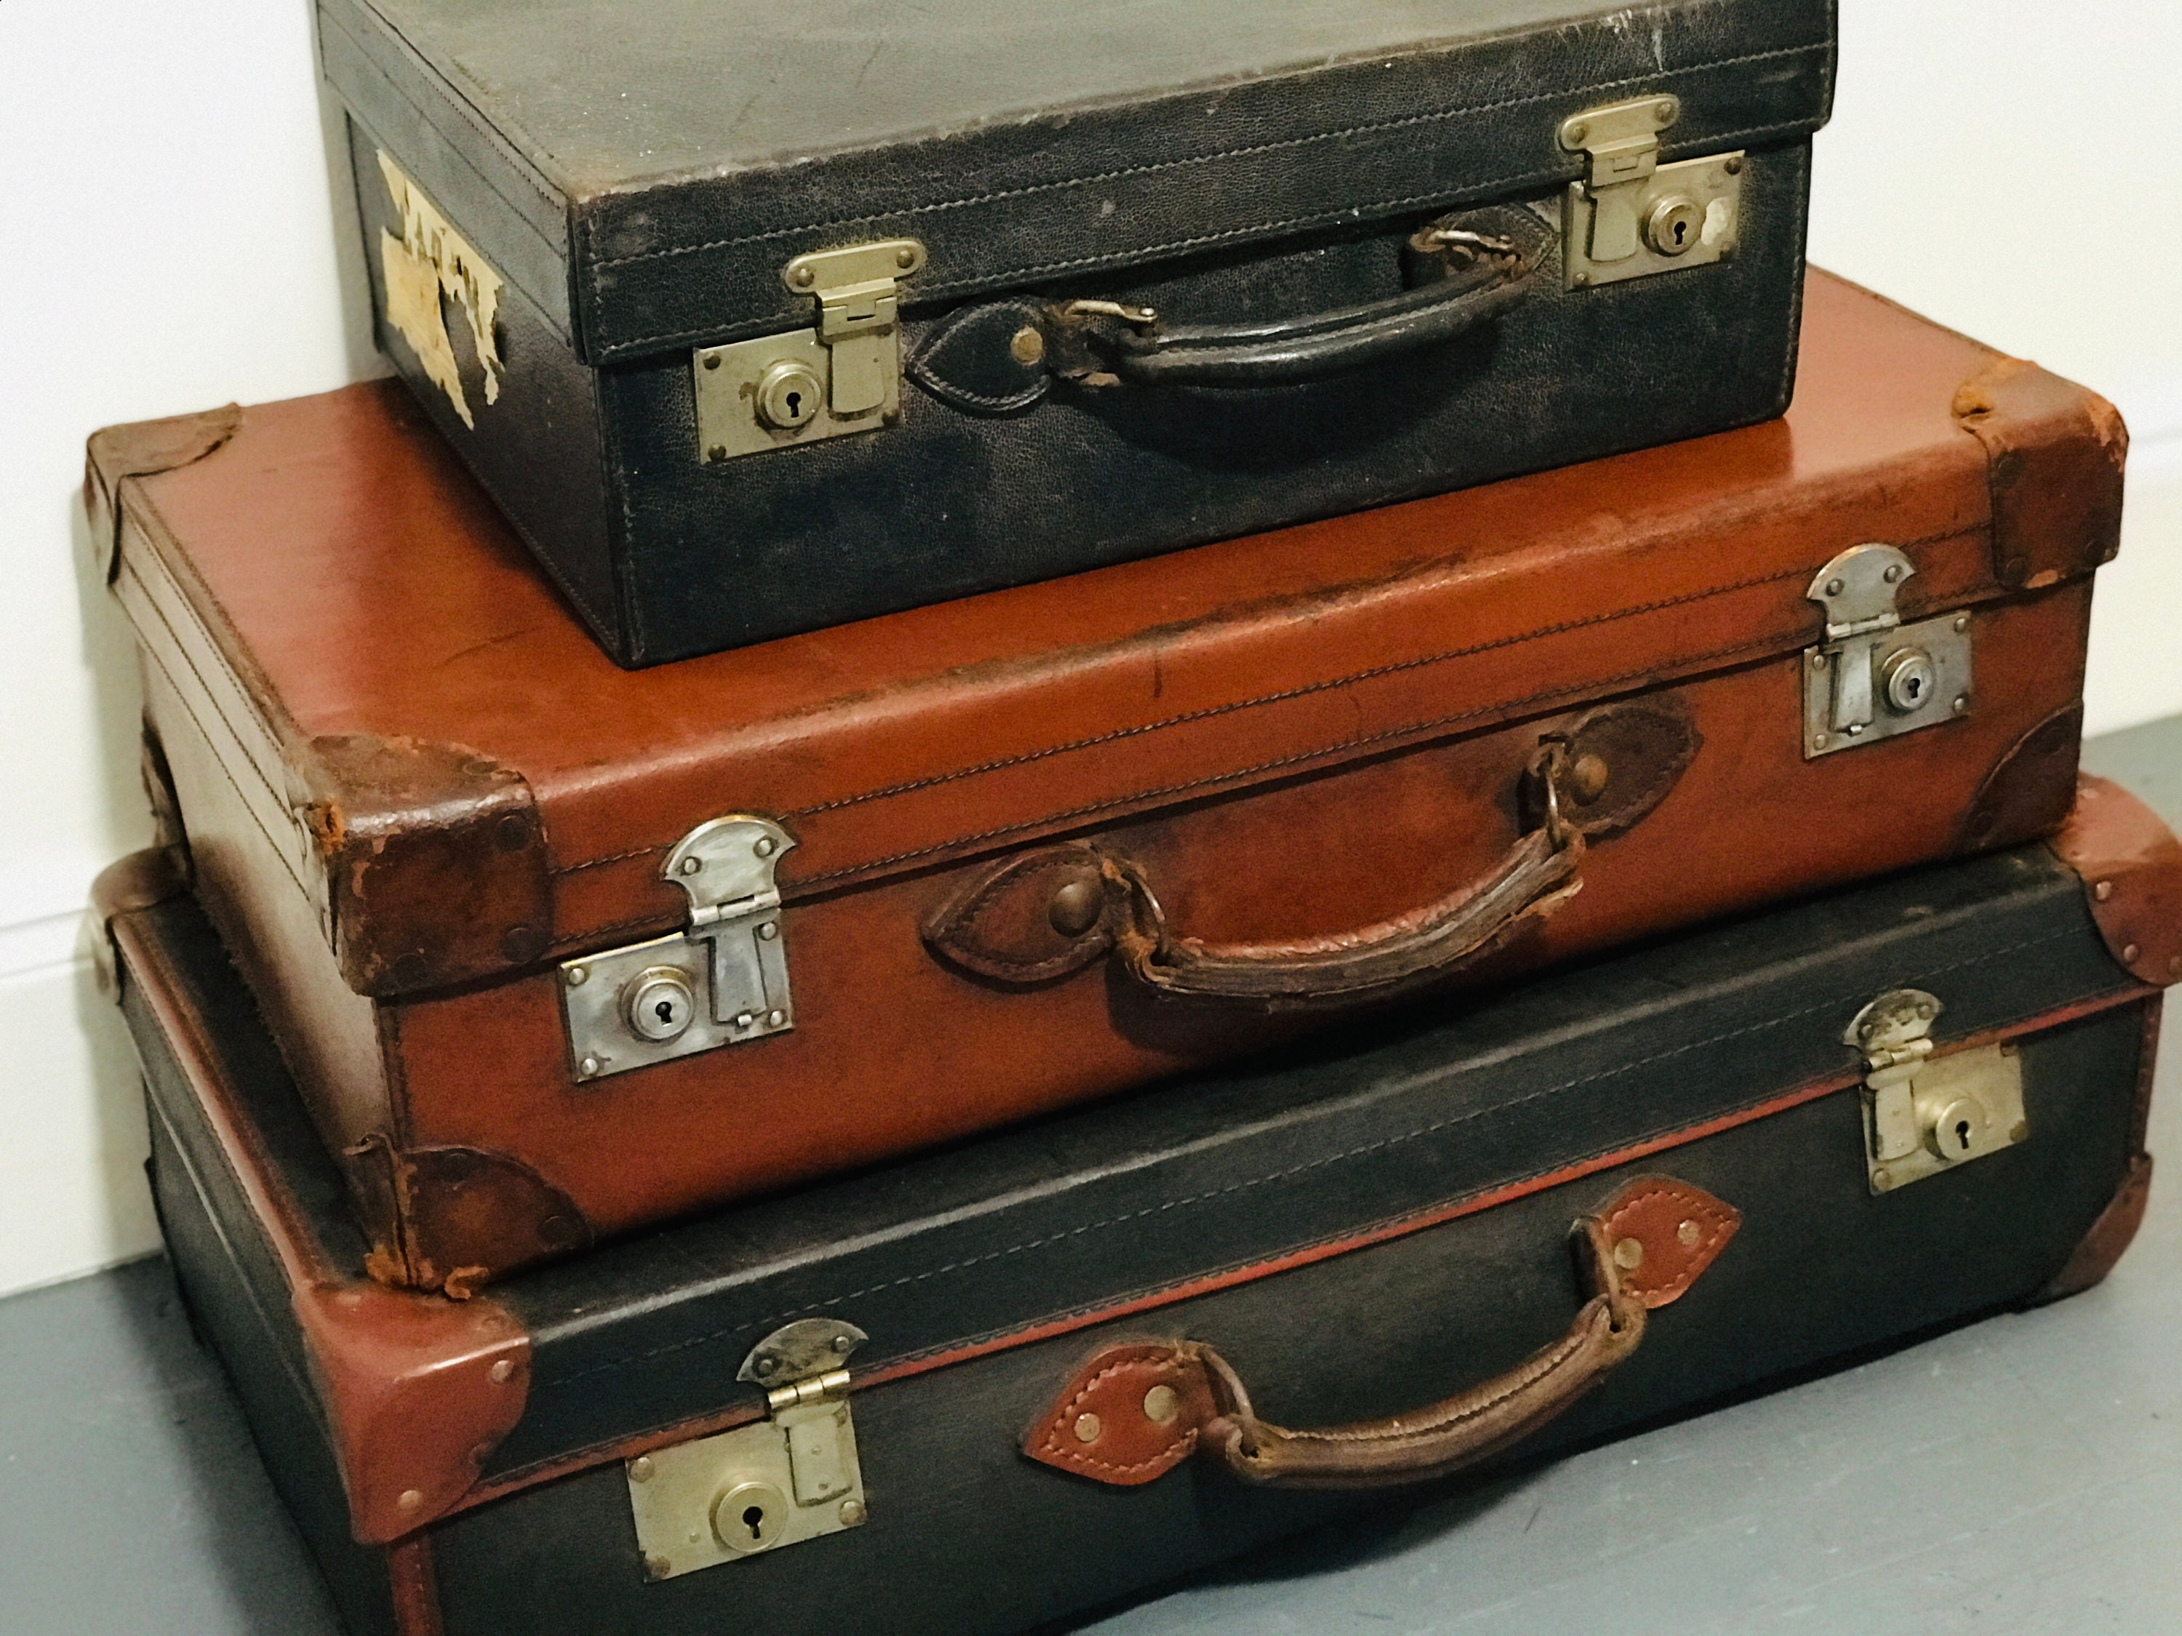
Why did people chose to travel on the Windrush ?
Following World War II, the UK desperately needed people to rebuild England and staff the NHS and public transport systems ,the government advertised for men , women and children to come to England . They were told the streets were almost paved with gold .
the Empire Windrush was the largest ship ever made for the purpose, people jumped to the chance so packed there bags and came to the land of hope and glory

Slide 4
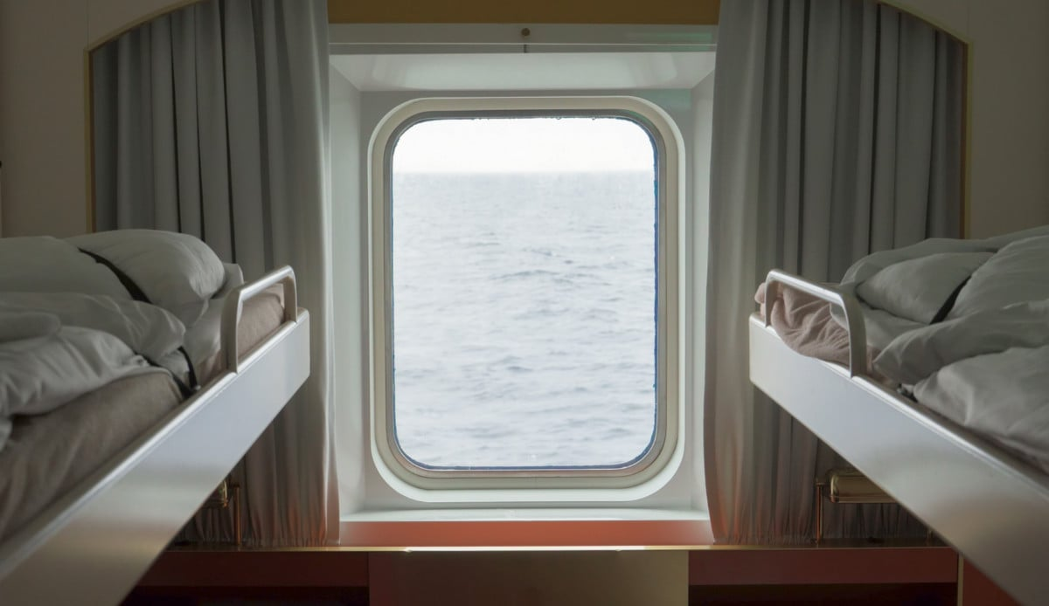
The features
On the famous 1948 voyage, men typically stayed in the cramped deck dormitories for £28, while women were required to pay £48 for cabin class.
It included a dining room and designated areas for passengers to relax or play game
The open deck allowed for fresh air and social interaction, with accounts of passengers dancing to music during the journey
The ship had 4 funnels and a single tall funnel in the center. It was built to carry roughly 1000-1500

Slide 5
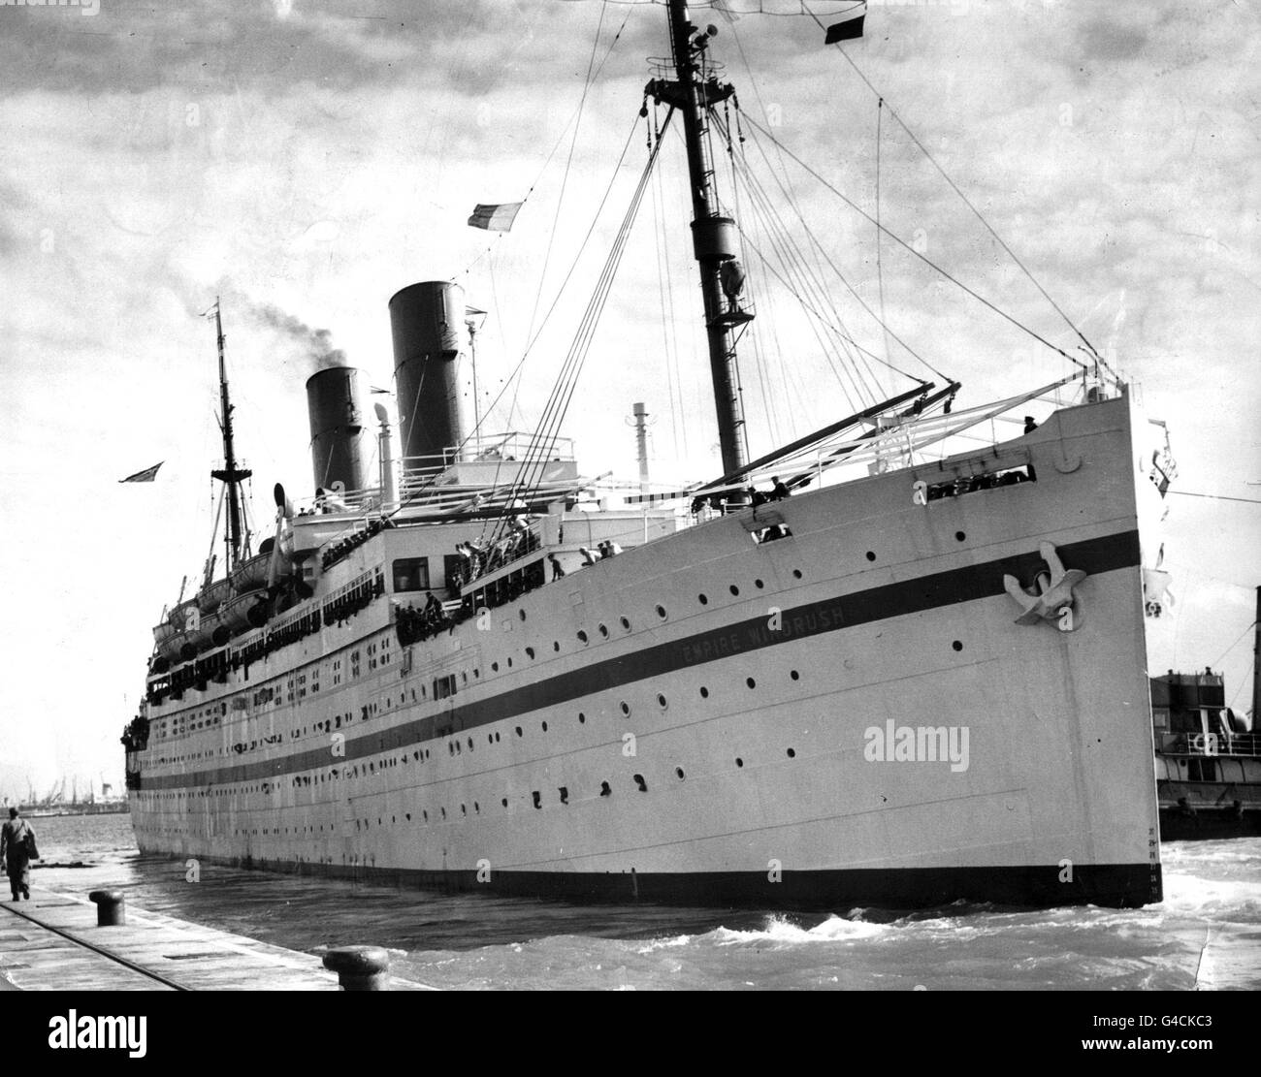
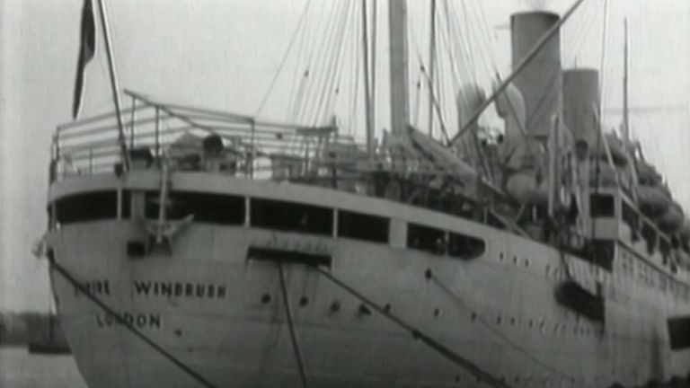
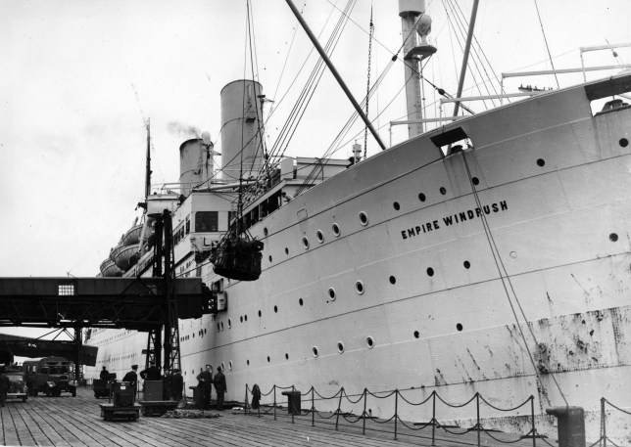
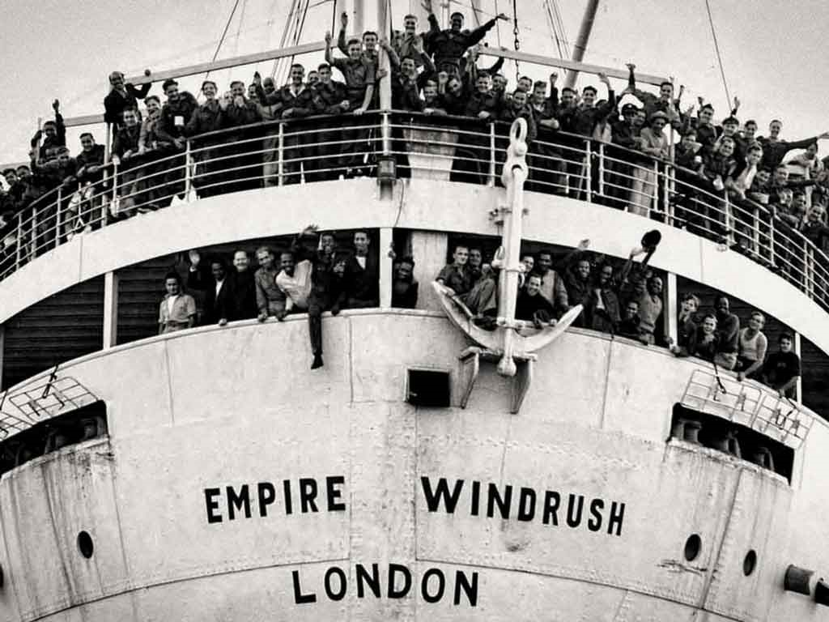

Slide 6
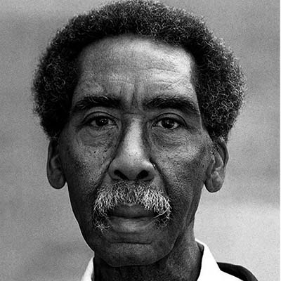
A man’s story
After the Windrush many people suffered racism and bullying.to help understand this I have found a Childs story …
Aged only 13, Vincent Reid, better known as Vince, was among the youngest passengers on the MV Empire Windrush, making the journey from Jamaica with his adoptive parents.
One of his early memories of life in England was how teachers at his school laughed at his Jamaican accent. Not surprisingly, he left as soon as possible and worked in the Post Office for a year before joining the Royal Air Force at the age of 16 as a mechanic. After seeing service in Malaya, he became a corporal at 19 before buying himself out.
He then worked at Heathrow airport, but left when his bosses refused to allow him time-off to continue his education. He found work as a market researcher in 1967 and met Elizabeth Evans, an English woman. Despite her being white they married in 1969 and went on to have two children
P.S here is a video of another child's story https://www.youtube.com/watch?v=iIFCoUHlnho

Slide 7
Thank you for listening !!!!!!!!!!!!!!!!!!!!!!!!!!!!!!!!!!!!!!!!!!!!!!!!!!!!!!!☺

