Slide 1
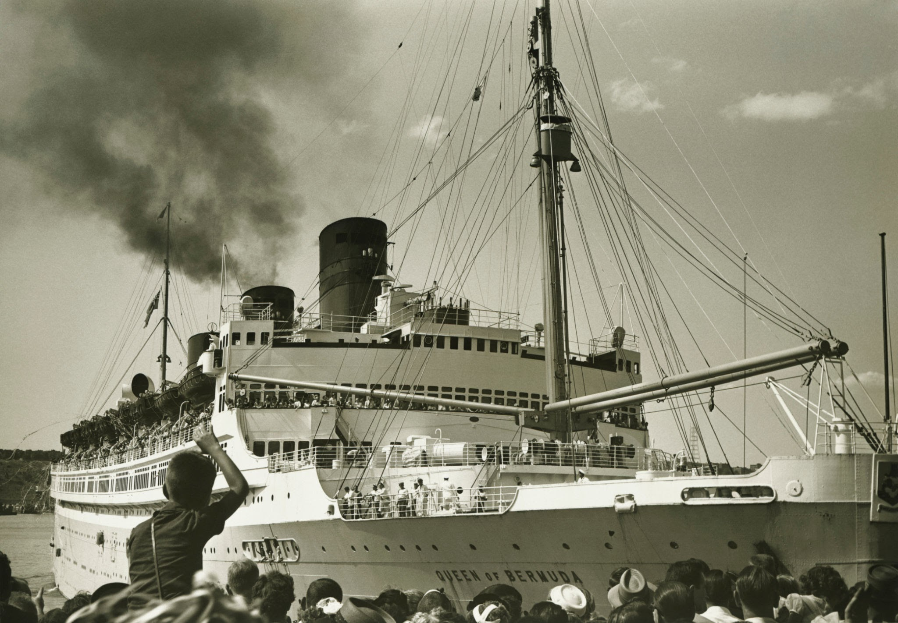
TH studios
HMT Windrush
By Teddy Hawkes

Slide 2
What was the HMT Windrush?
THstudios
MV monte rosa was a passenger motor ship that was launched in Germany in 1930 She was built as an ocean liner for the German shipping company Hamburg Süd. They used the ship to carry German emigrants to South America, and as a cruise ship. During World War II, she was taken over by the German navy and used as a troopship. After World War II, the United Kingdom seized the ship as a prize of war and renamed her HMT Empire Windrush.
Empire windrushs biggest journey was from jamaica to england bringing many people with it.Several weeks before the ship left the United Kingdom, advertisements had been placed in a Jamaican newspaper, ,offering cheap passage on the ship's return voyage; advertisements were also placed in newspapers in many other places as well but Jamaica was the majority. However, the cheapest fares were only available to men, who were accommodated in the large, dormitory areas usually allocated to troops. Women were required to travel in the ship's two and four-berth cabins, that cost considerably more.
Many former servicemen took this opportunity to return to Britain in hope of finding better employment. Some wished to rejoin the RAF. Others decided to make the journey just to see what the "mother country" was like.

Slide 3


The Ship
TH studios
Length:500.3 ft (152.5m)
speed:14 knots (26 km/h)
Crew:222
Depth:37.8 ft (11.5 m)
decks:4,

Slide 4
Time in service
TH studios
Built in 1930 called Monte Rosa :Germany
Commandeered by the German Navy as a battleship
Survives world war 2 and is taken as a prize of war:Britain
Most famous voyage from the caribbean to england :1948
Destroyed by fire in the mediterranean losses:4 of the crew died in an explosion only 12 of the 22 lifeboats were launched .

Slide 5
The end of Empire Windrush
TH studios
In February 1954 Empire Windrush left Yokohama for the UK.
At around 0617 hrs on 28 March, Windrush was in the western Mediterranean, off the coast of Algeria, When suddenly a fire burst up.Both the Chief Officer and the Master were on the bridge. They heard the explosion, and saw black smoke and flames coming from the funnel. Attempts were made to contact the engine room by telephone—it was heard ringing but was not answered. At 0623 hrs the Radio Officer broadcast the first distress signal. This was acknowledged by two French ships, and by radio stations Although the ship's 22 lifeboats could accommodate all aboard, thick smoke and the lack of electric power prevented many of them from being launched .About 26 hours after Empire Windrush was abandoned, HMS Saintes of the Royal Navy's Mediterranean Fleet reached her. The fire was still burning fiercely more than a day after it started.
The bodies of the four men killed were not recovered and were lost when she sank. The wreck lies at a depth of about 2,600 m (8,500 ft).

Slide 6
Other Facts
TH studios
There was space for over 1000 people!
Was called HMT instead of HMS because HMT stands for his
majesty's troopship
3.The price of a ticket was £28 and 10 shillings
4.The wind rush took 30 days from the caribbean to england.

Slide 7
The Windrush generation
TH studios
In June 1948, the Empire Windrush sailed into Tilbury Docks, near London, carrying 1,027 passengers, many of whom were from the Caribbean, especially Jamaica.
These people had been invited by the British government to help rebuild the country after the war.
This marked the beginning of what we now call the Windrush Generation.
The Windrush Generation includes people who arrived in the UK from the Caribbean between 1948 and 1971.
They brought skills, culture and energy to help rebuild post-war Britain.
Today, they and their families are an important part of British life, contributing in schools, hospitals, transport, the arts and more.
Sadly many children who came on there parents passports have been sent back to jamaica as they never had passport of their own.They could of made a life of their own and now all that is gone.

Slide 8
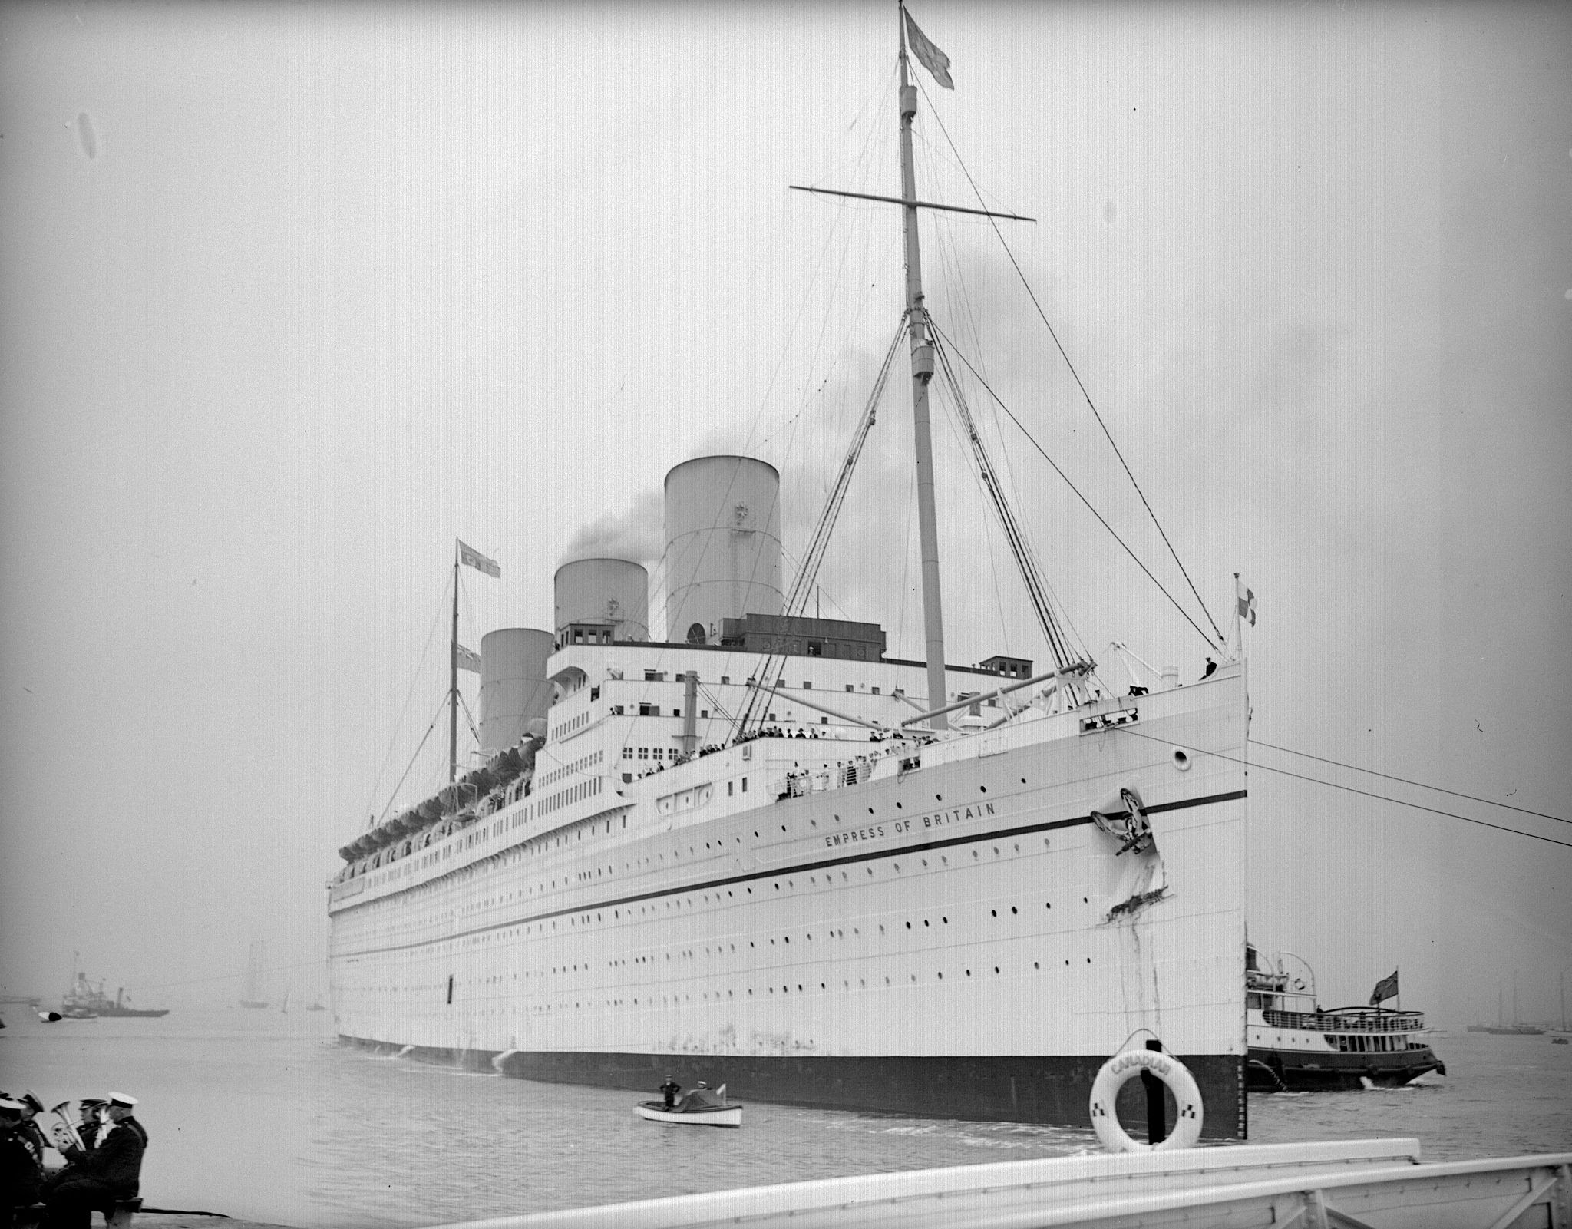
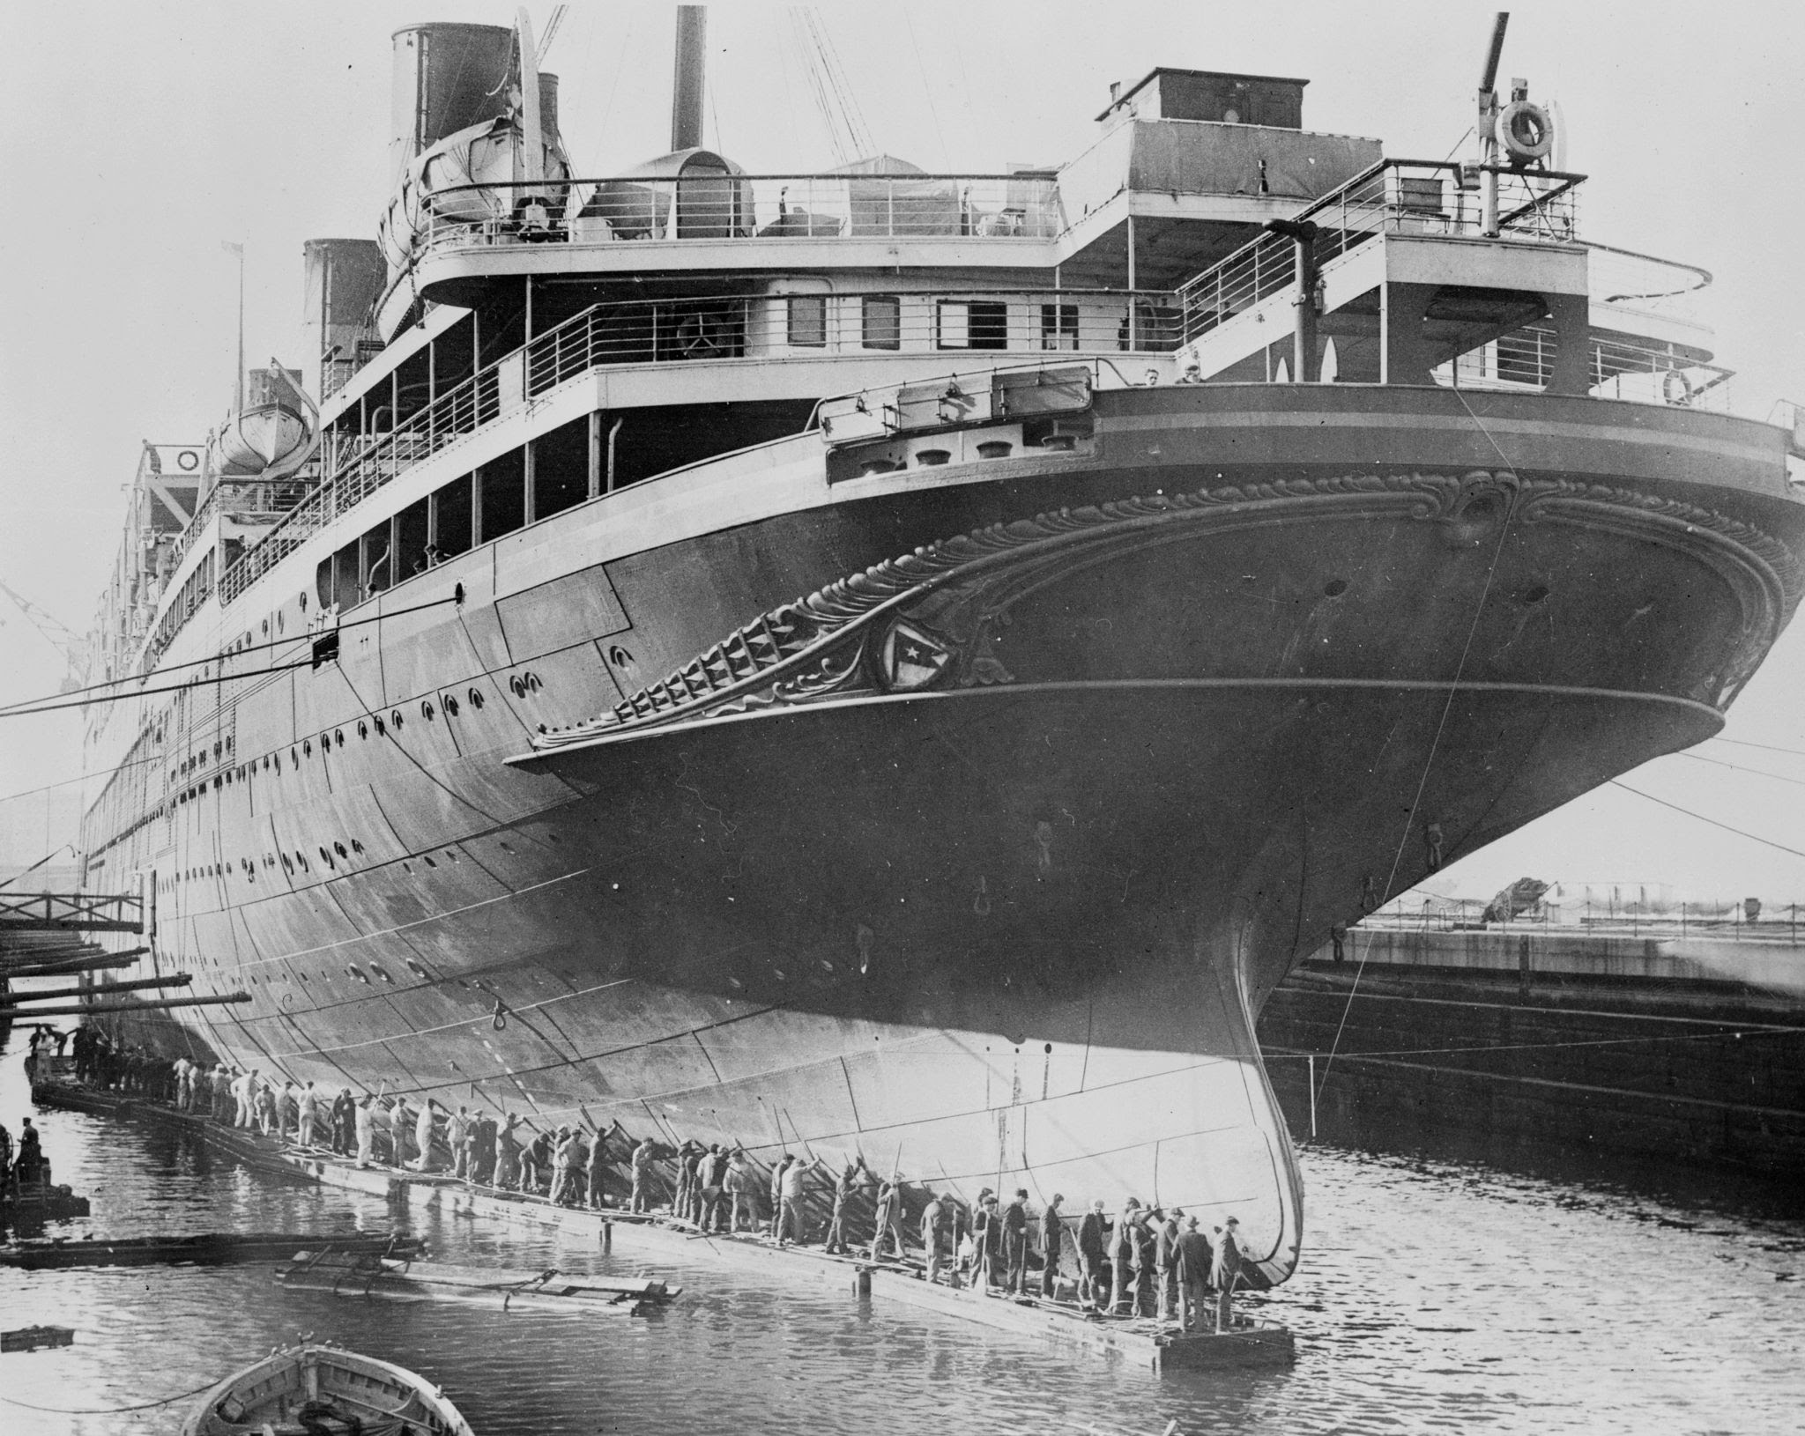
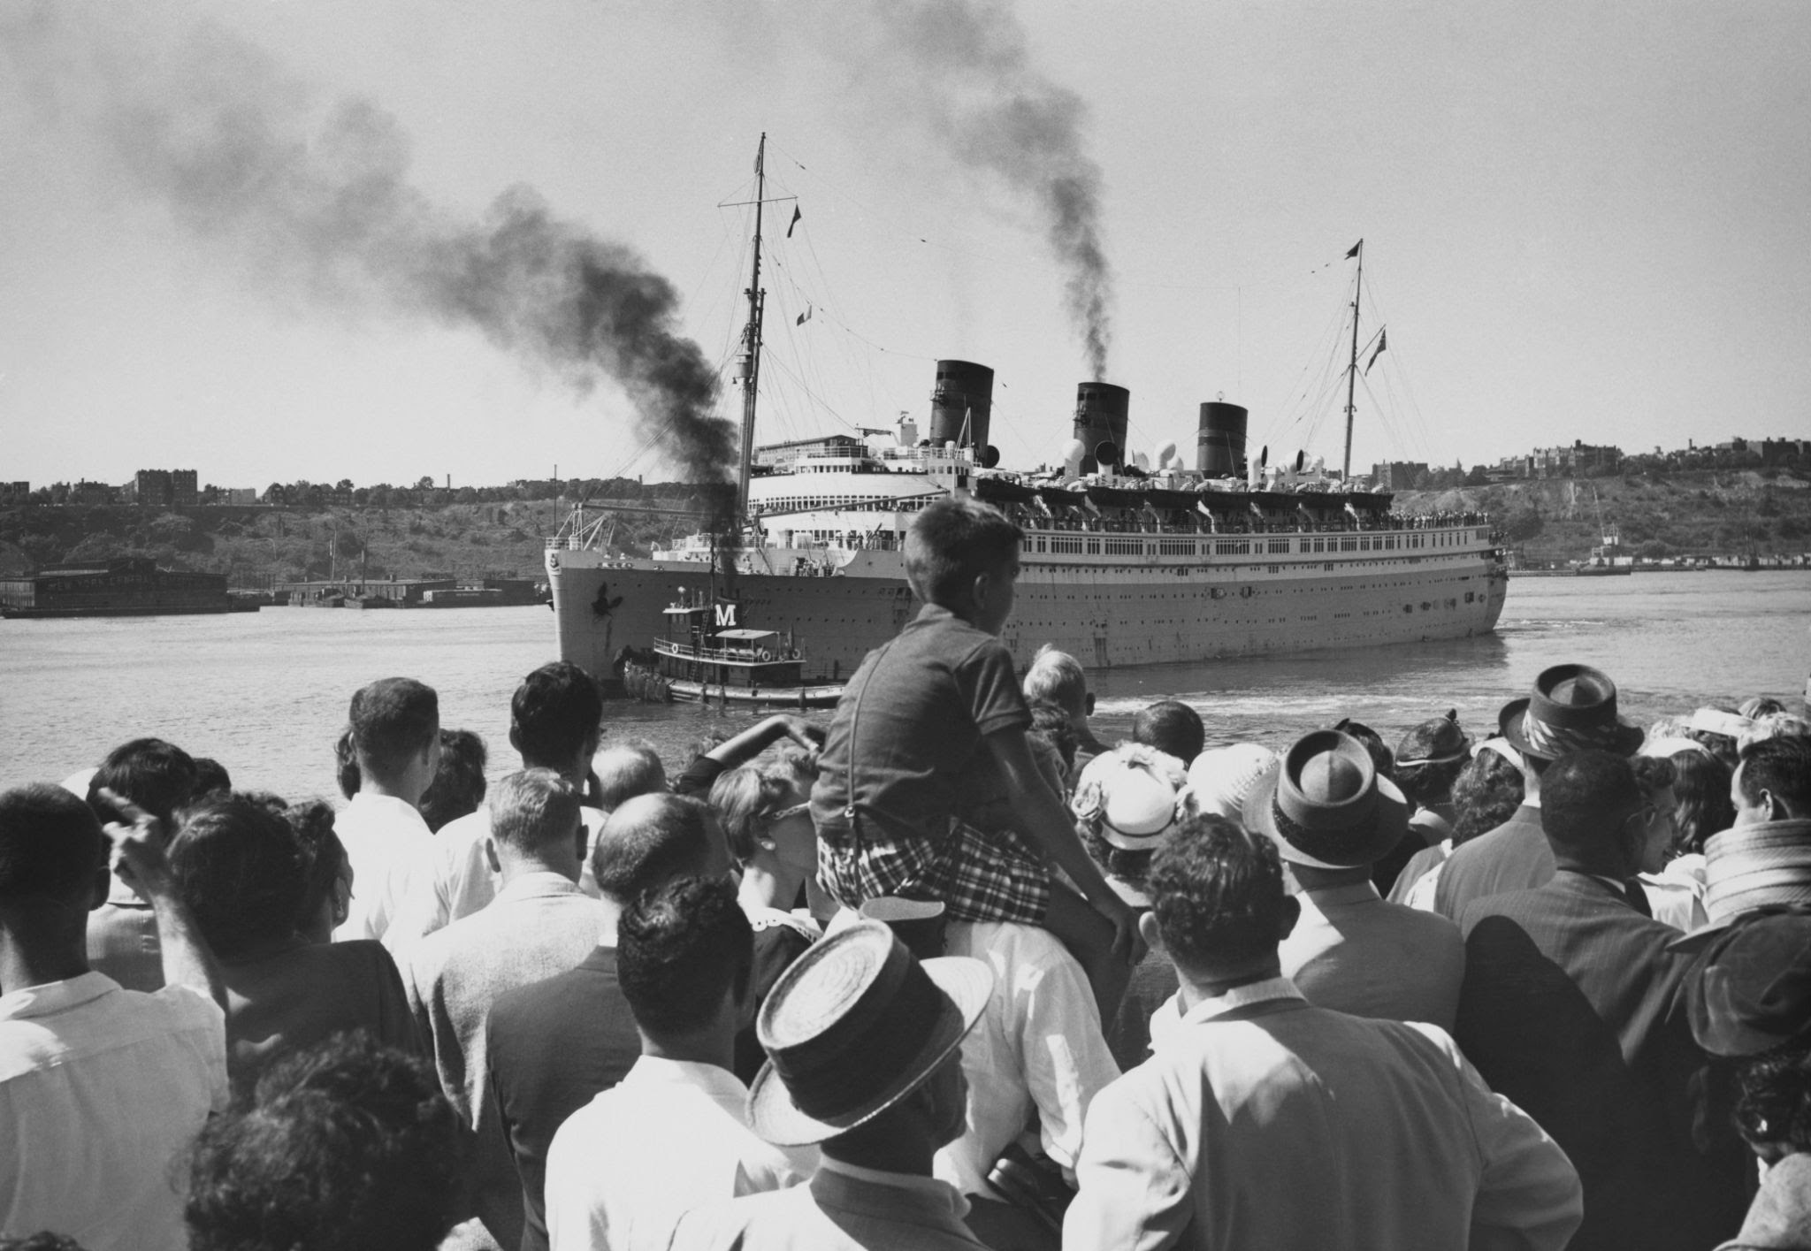
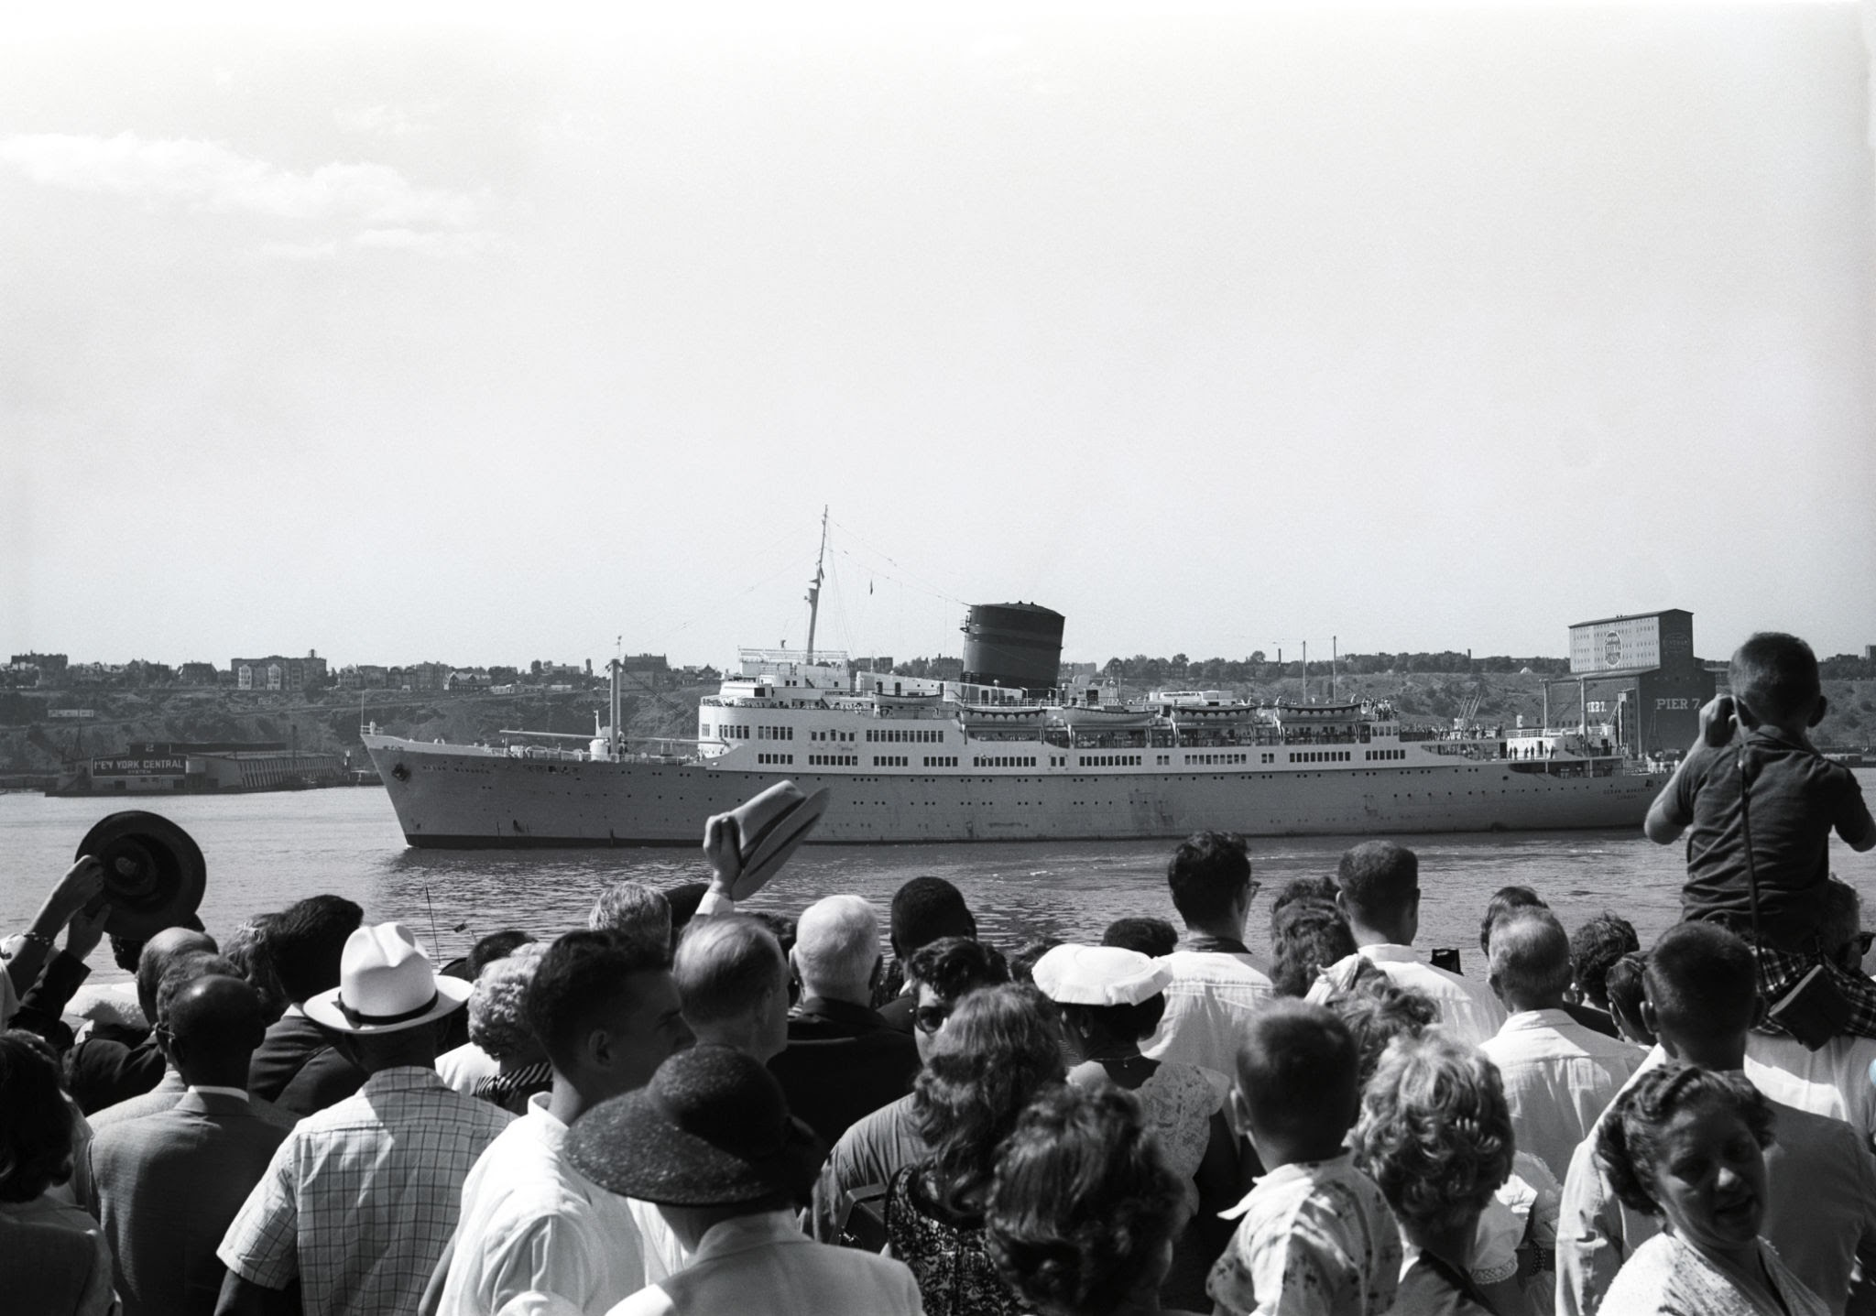
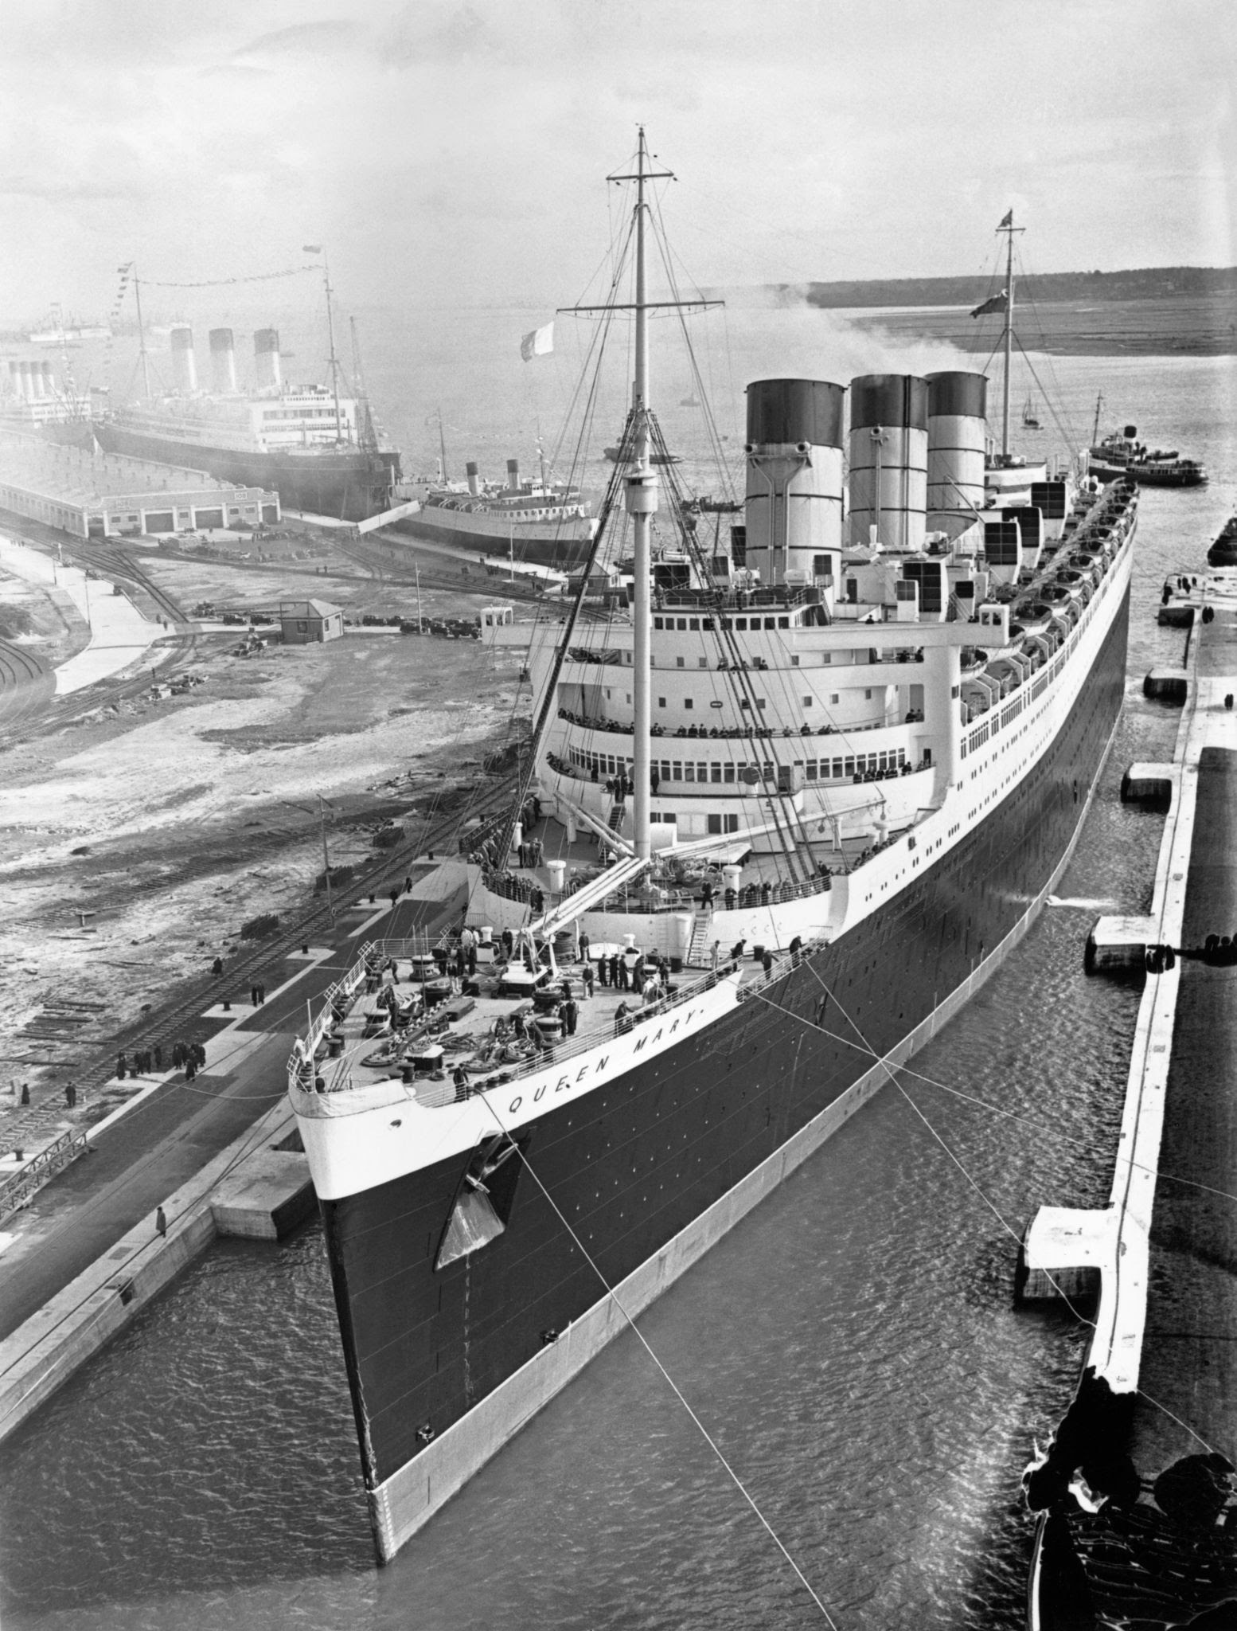
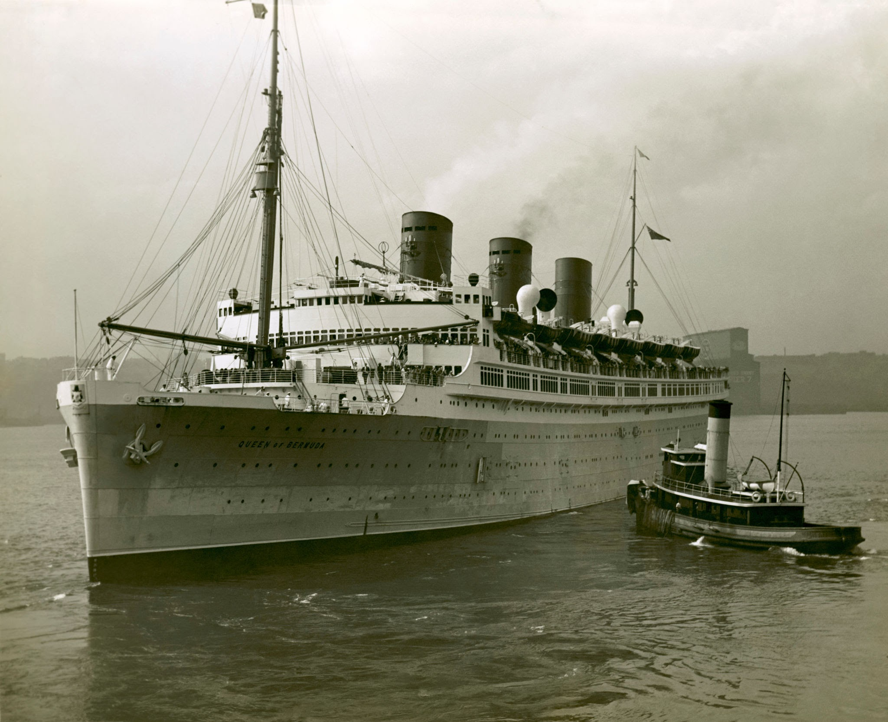
Thank you for listening!

Slide 9
THstudios

