Slide 1
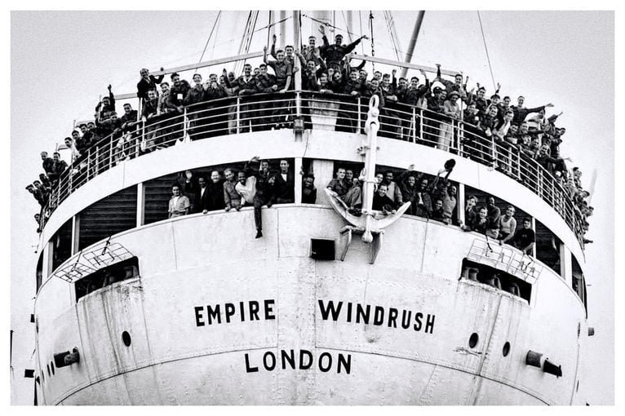
Empire Windrush
By Harry Hawkes

Slide 2
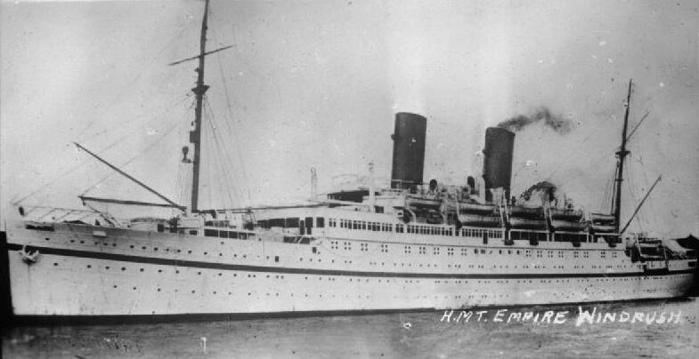
What was HMT Empire Windrush?
HMT Empire Windrush was a passenger motor ship that was launched in Germany in 1930 as the MV Monta rosa. She was built as an ocean liner for the German shipping company Hamburg Südd. They used the ship to carry German emigrants to South America, and as a cruise ship. During World War II she was taken over by the German navy and used as a troopship. During the war, she survived two Allied attempts to sink her.
MV Monte Rosa was captured as a prize of war by the British in 1945. A year later the ship was renamed the Empire Windrush. On 15 April 1948, a small advertisement appeared in the Daily Gleaner newspaper in Jamaica.
It announced a "passenger opportunity" to sail to the United Kingdom on the HMT Empire Windrush to rebuild London after WW2.

Slide 3
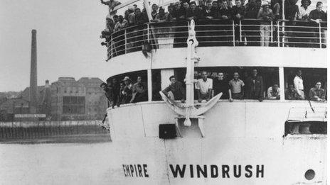
The ship
Weight:14,414 tones
Length:500.3 feet [252m]
Depth:37.8 feet [11.5m]
Width:65.7 feet [20m]

Slide 4
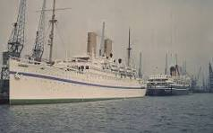
Time in service
The Empire Windrush was in service from its launch in 1930 (originally as the German ship Monte Rosa) until it caught fire and sank in the Mediterranean in March 1954.

Slide 5
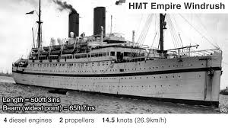
The Windrush Generation
After the Second World War, there were many labour shortages, particularly in the NHS. The UK government invited these British citizens to come to the UK, also known at that time as the ‘mother country’, to help rebuild the UK economy. The government offered cheap transportation as an incentive, and one of the first ships used was the HMT Empire Windrush. Some worked in industries such as transport and manufacturing.

Slide 6
Facts
1.The ship docked at Tilbury docks Essex on June 22, 1948, bringing over 1,000 passengers.
2. The journey from the Caribbean took 3 weeks.
3. Dominoes was a very popular game on the Empire Windrush.
4. Nearly half a million people came to Britain in between 1947 and1970.
5. It was renamed after the River Windrush, which flows through the Cotswolds in England.
6. The Empire Windrush carried Lord Kitchener who sang, London is the place for me.

Slide 7
The final voyage
The Windrush continued to be used as a troop carrier into the 1950s, including transporting British soldiers to Korea in October 1950 as part of the United Nations forces involved in the Korean War.
In February 1954 the Windrush set sail from Yokohama in Japan on what would prove to be its final voyage.
On 28 March, while the Windrush was sailing off the coast of Algeria, an explosion in the engineroom resulted in a huge fire.
Four members of the crew - G.W. Stockwell, J.W. Graves, A. Webster and L. Pendleton - were killed in the explosion, but the remaining crew and all 1,276 passengers were saved. The Guardian called it "one of the greatest rescues in maritime history".

Slide 8
The End
Produced by
Harry Hawkes

